Slide 1
Biopsy Evaluation of
Inflammatory Bowel Disease:
Diagnosis, Differentials, and Dysplasia
Raul S. Gonzalez, MD
Emory University Hospital

Slide 2
Disclosure of Relevant Financial Relationships
I have done consulting work for
  Astellas Pharma Inc
  Bristol Myers Squibb
  GlaxoSmithKline
  Vertex Pharmaceuticals
No information related to these activities will be discussed in this talk
RDC Nº 96/08 da ANVISA

Slide 3

Diagnosing Inflammatory Bowel Disease on Bx
When I see colitis on biopsy, my main question is always
Is it IBD?
Subtyping IBD (ulcerative colitis vs. Crohn disease, +/- indeterminate) can be hard enough on resection
I’m not brave enough to attempt it on biopsy

Slide 4
Ulcerative Colitis vs. Crohn Disease: Challenges
UC can be patchy!
Treated disease
“Cecal patch”
UC can have granulomas
Crypt-rupture granulomas, that is
Rare upper GI tract involvement in UC
Usually duodenitis
Unusual overlap forms exist
“UC-like CD” and etc.

Slide 5
New DX of IBD on Biopsy: Activity
Usually want to see both activity and chronicity
Activity = neutrophils
Various severity criteria have been proposed
Minimal = barely found one neutrophil
Mild = scattered neutrophils in epithelium or lamina propria
Moderate = crypt abscesses
Severe = ulceration

Slide 6
New DX of IBD on Biopsy: Chronicity
Expanded lamina propria chronic inflammatory infiltrate
Crypt lift-off with basal plasmacytosis
Paneth cell metaplasia distal to splenic flexure
Crypt dropout/atrophy
Crypt distortion/branching
All features helpful; none hugely sensitive or specific

Slide 7

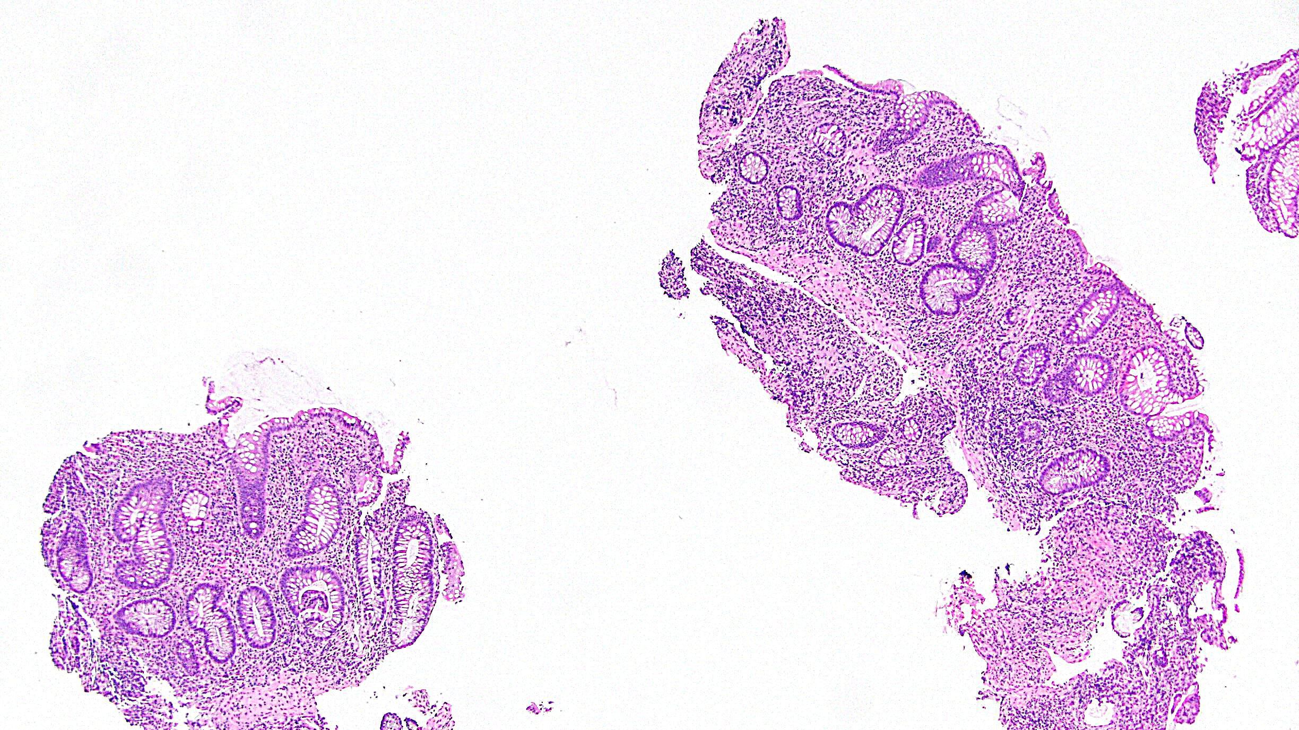
UC on biopsy

Slide 8
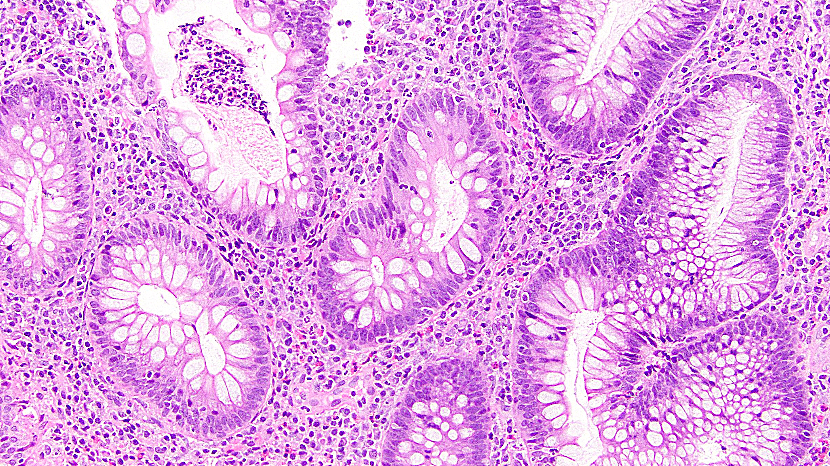
UC on biopsy

Slide 9
CD on biopsy

Slide 10
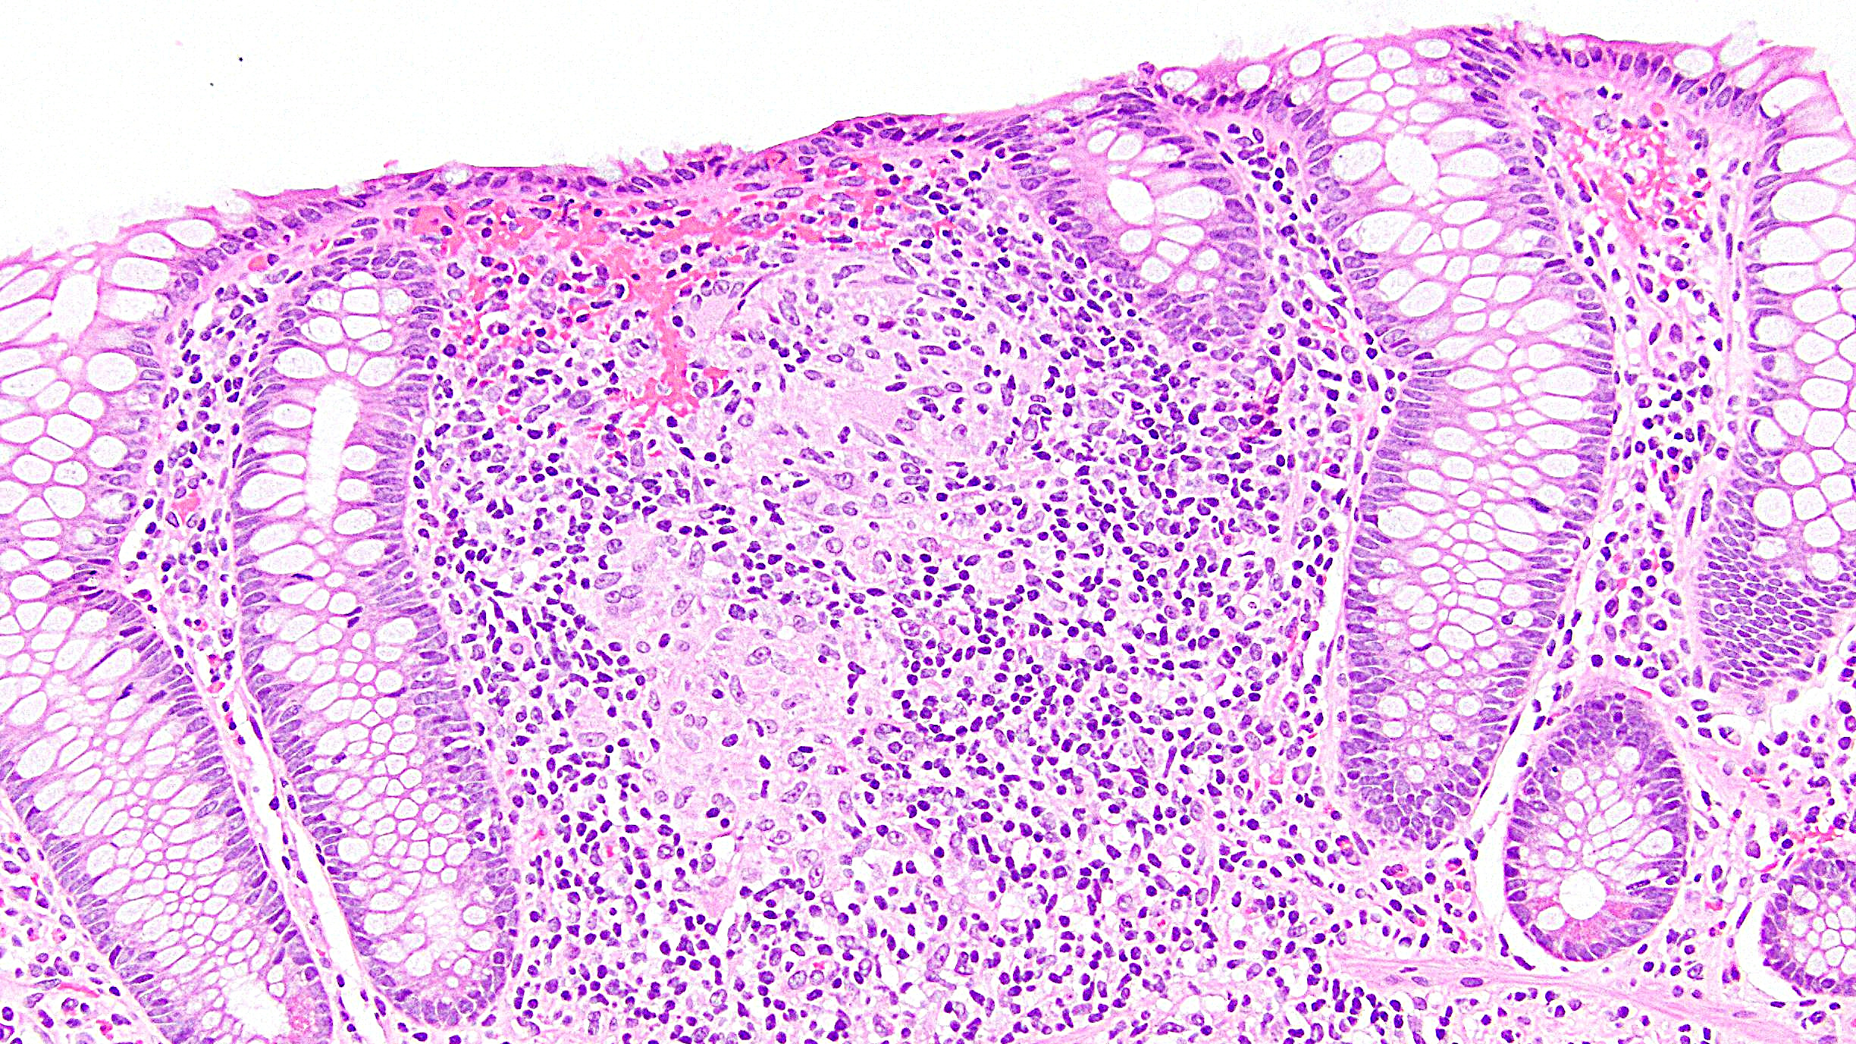
CD on biopsy

Slide 11
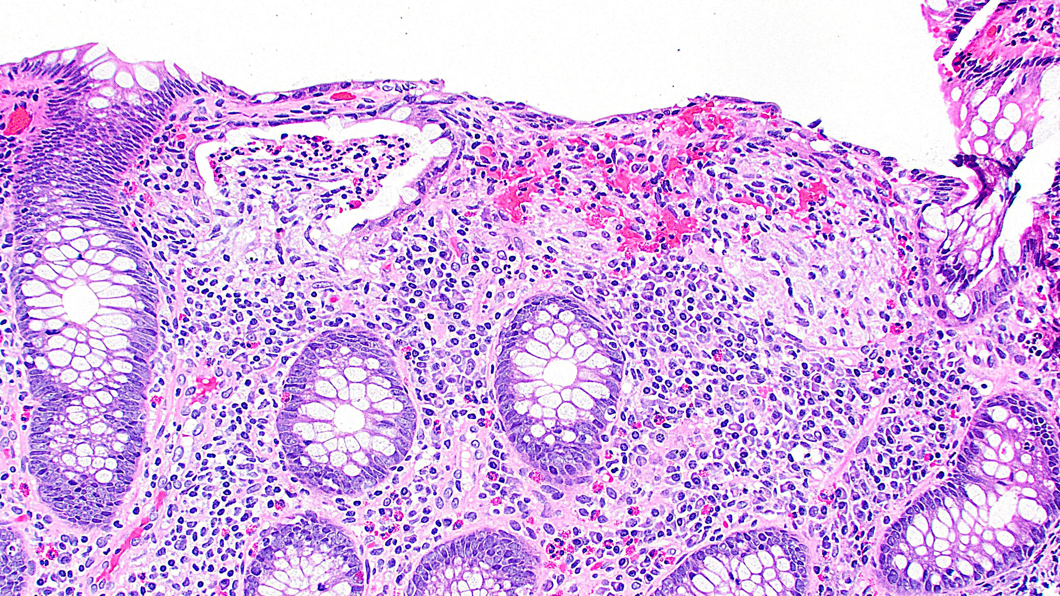
UC on biopsy

Slide 12
Scoring IBD Activity
Dozens of scoring systems have been proposed
Conclusion from review of CD systems:
Currently there is no fully validated histological scoring index for evaluation of Crohn’s activity
Conclusion from review of UC systems:
The Nancy Index and the Robarts Histopathology Index have undergone the most validation … However, none of the currently available histologic scoring indices have been fully validated

Slide 13
My Signout Approach (Bx, Hx of IBD)
Colonic mucosa within normal limits
Inactive chronic colitis
Minimally active chronic colitis
Mildly active chronic colitis
Moderately active chronic colitis with crypt abscesses
Severely active chronic colitis with ulceration
Comment: The patient’s reported history of [UC / CD] is noted. No granulomas or dysplasia seen.

Slide 14
My Signout Approach (Bx, no Hx of IBD)
Descriptive topline: “Colonic mucosa with architectural distortion and acute inflammation”
1. I really think it’s IBD, but there’s no history:
“The findings are not specific but are compatible with inflammatory bowel disease in the proper clinical context.”
2. I think it might be IBD (or the clinicians do), but it’s really not clear:
“The findings are not specific. The differential diagnosis includes acute self-limited/infectious colitis, medication-induced injury, and inflammatory bowel disease.”
(Adjust the ddx as needed)

Slide 15
DDX of IBD on Biopsy
Acute self-limited / infectious colitis
Segmental colitis
Diversion colitis
Drug-induced colitis

Slide 16
Acute Self-Limited Colitis
Transient colitis, usually infectious
Histology does not readily correspond to organism
Additional testing needed
Culprits include Shigella, Salmonella, Campylobacter, E. coli, Vibrio
Clinical: rapid onset of symptoms (fever, abdominal pain, diarrhea)
Histology: prominent acute inflammation, usually without
definitive chronicity

Slide 17
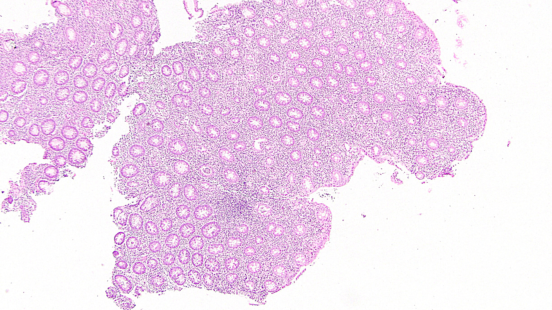
Acute self-limited colitis

Slide 18
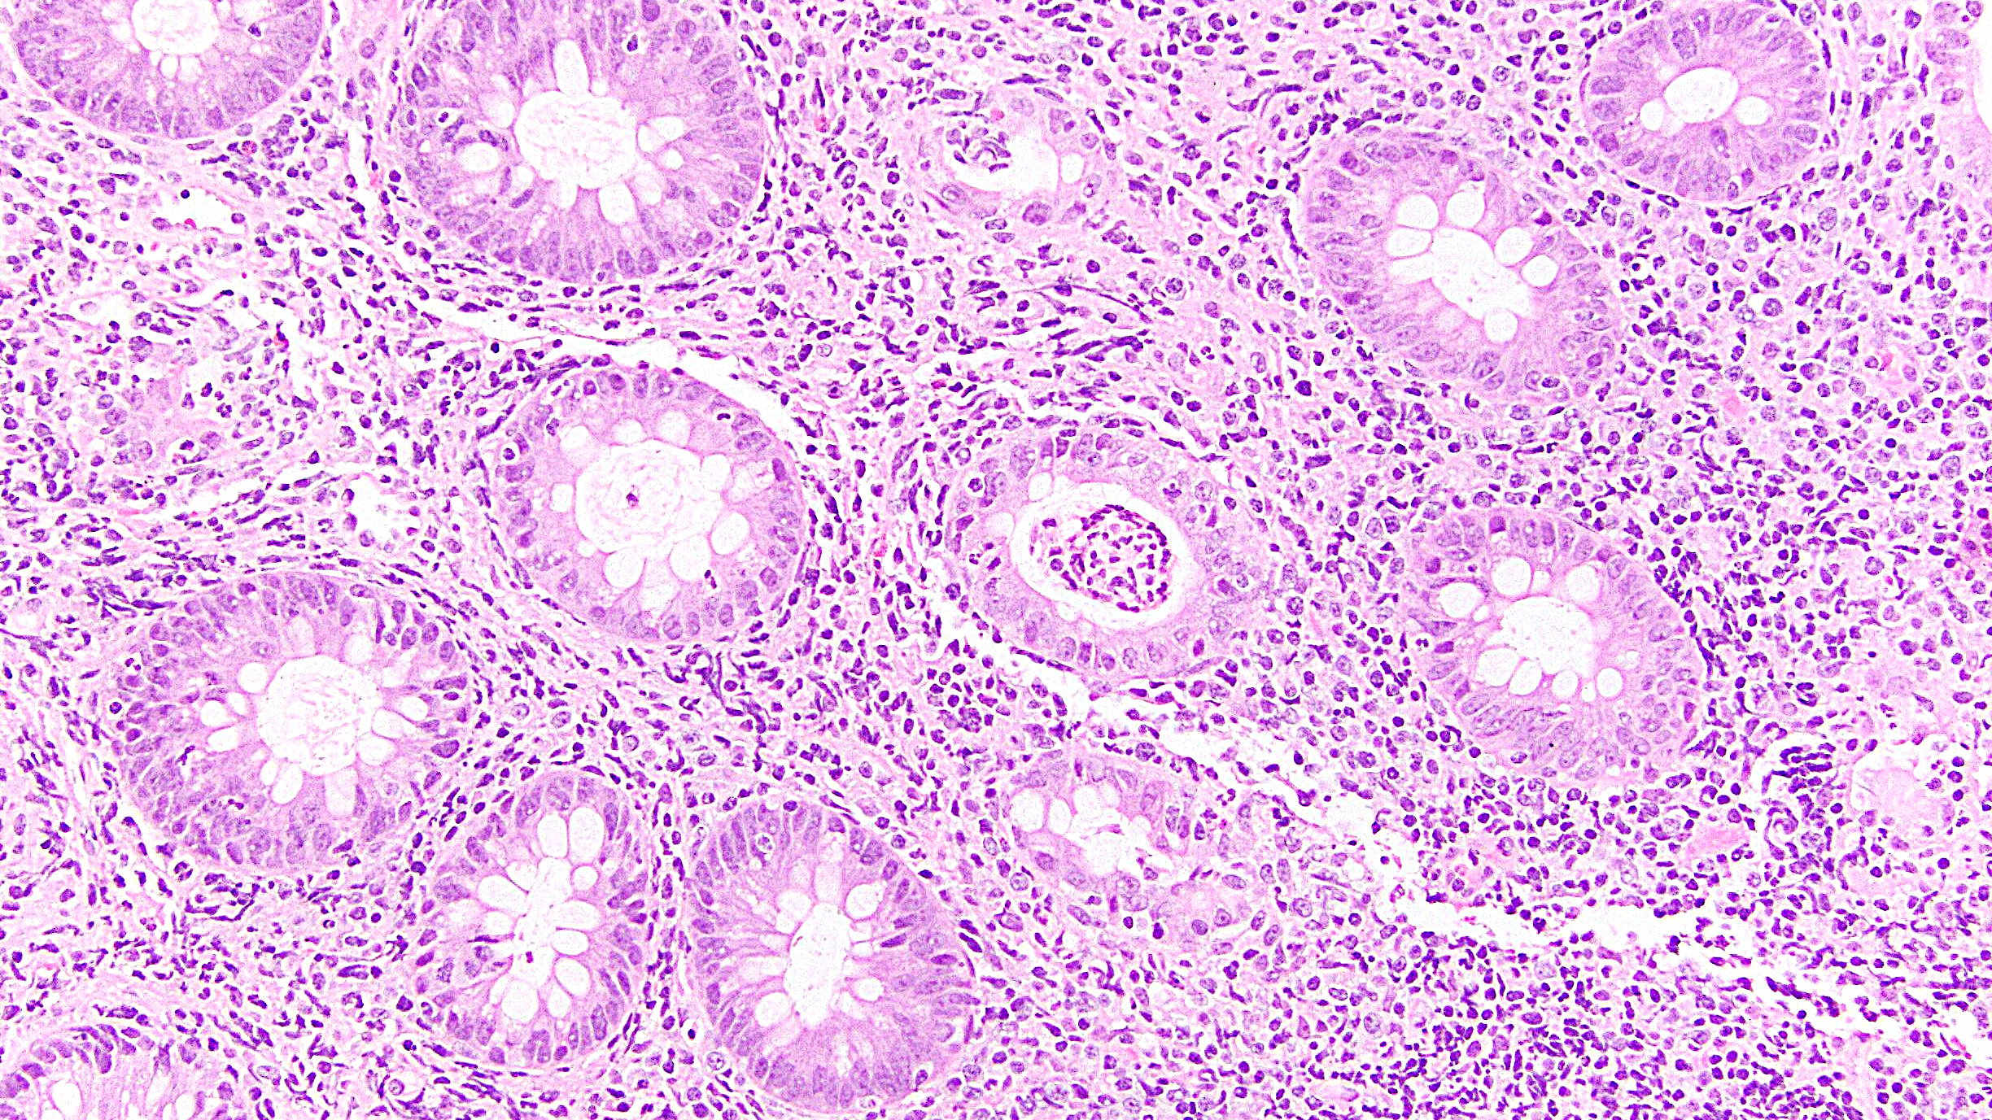
Acute self-limited colitis

Slide 19
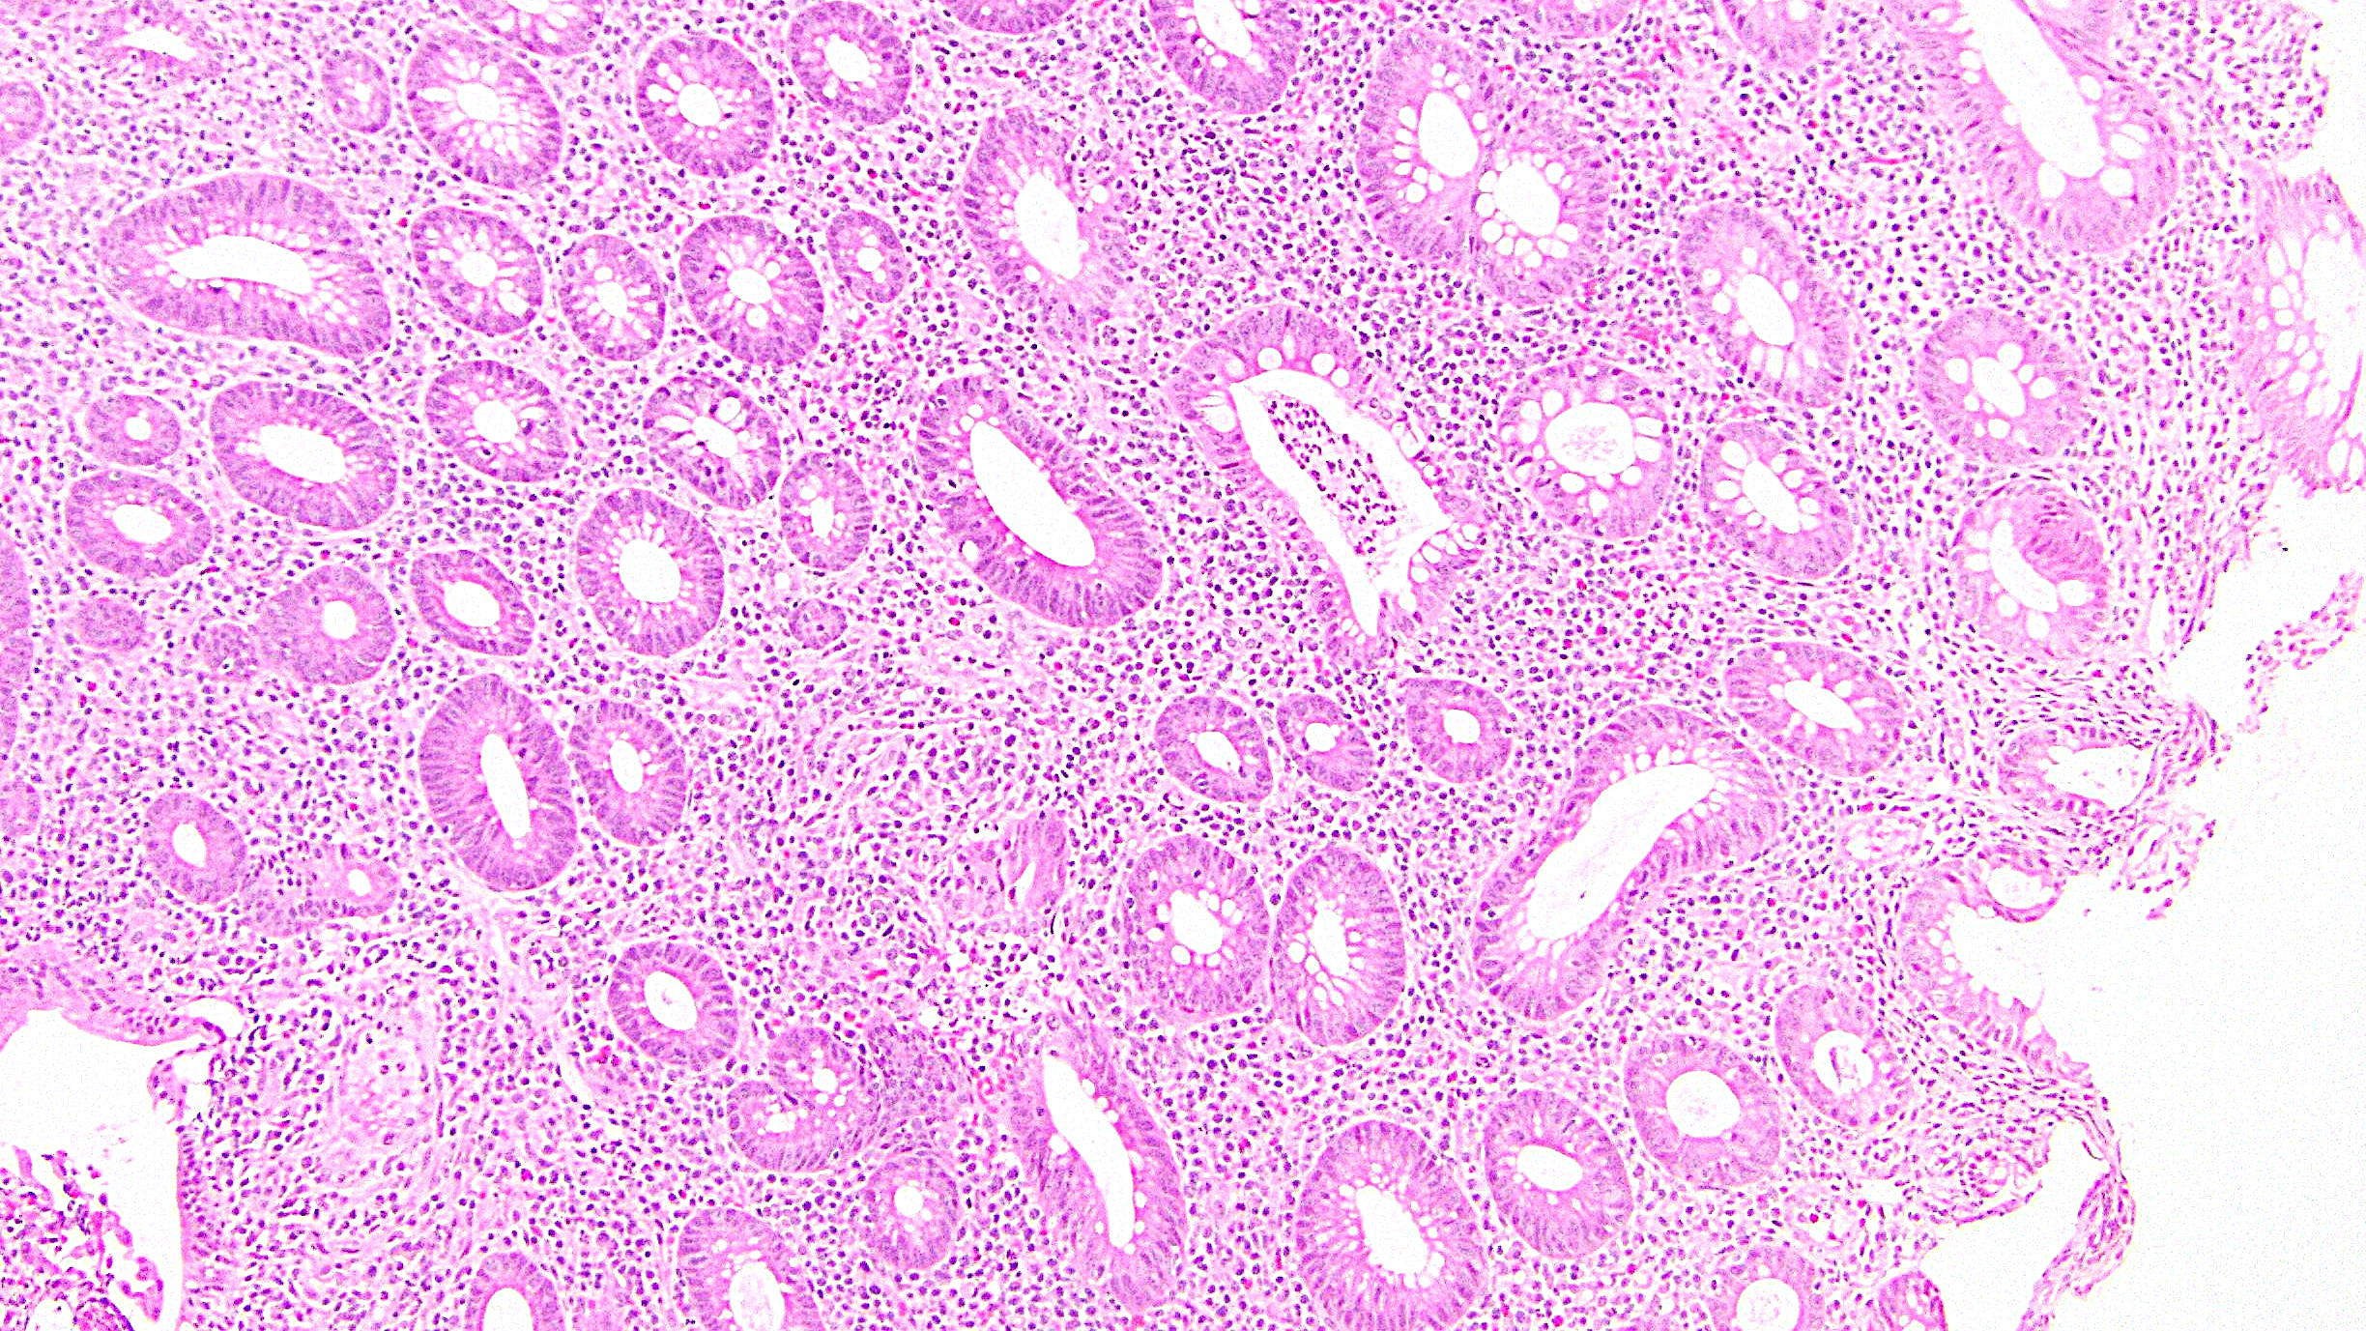
Acute self-limited colitis

Slide 20
Segmental Colitis
Mucosal injury in regions of diverticulosis (SCAD)
Knowing that the colonoscopy showed diverticuli is vital!
Remember: diverticuli usually in sigmoid, but can occur anywhere
Histology: can strongly mimic IBD (LP expansion, crypt abnormalities, Paneth cell metaplasia) or simply acute colitis (PMNs)
Crypt abscesses, marked crypt distortion, crypt rupture, and Paneth cell metaplasia may be more common in IBD than in SCAD

Slide 21
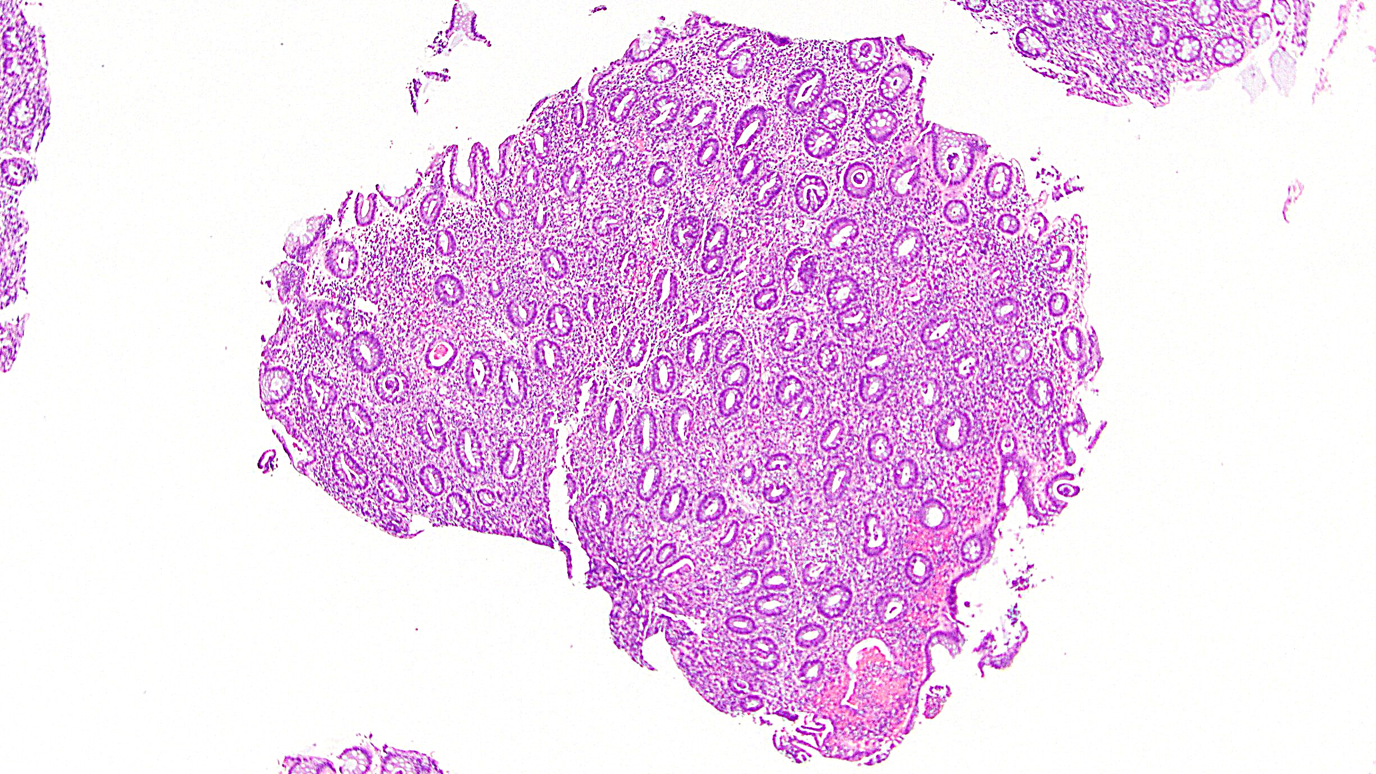
Segmental colitis

Slide 22
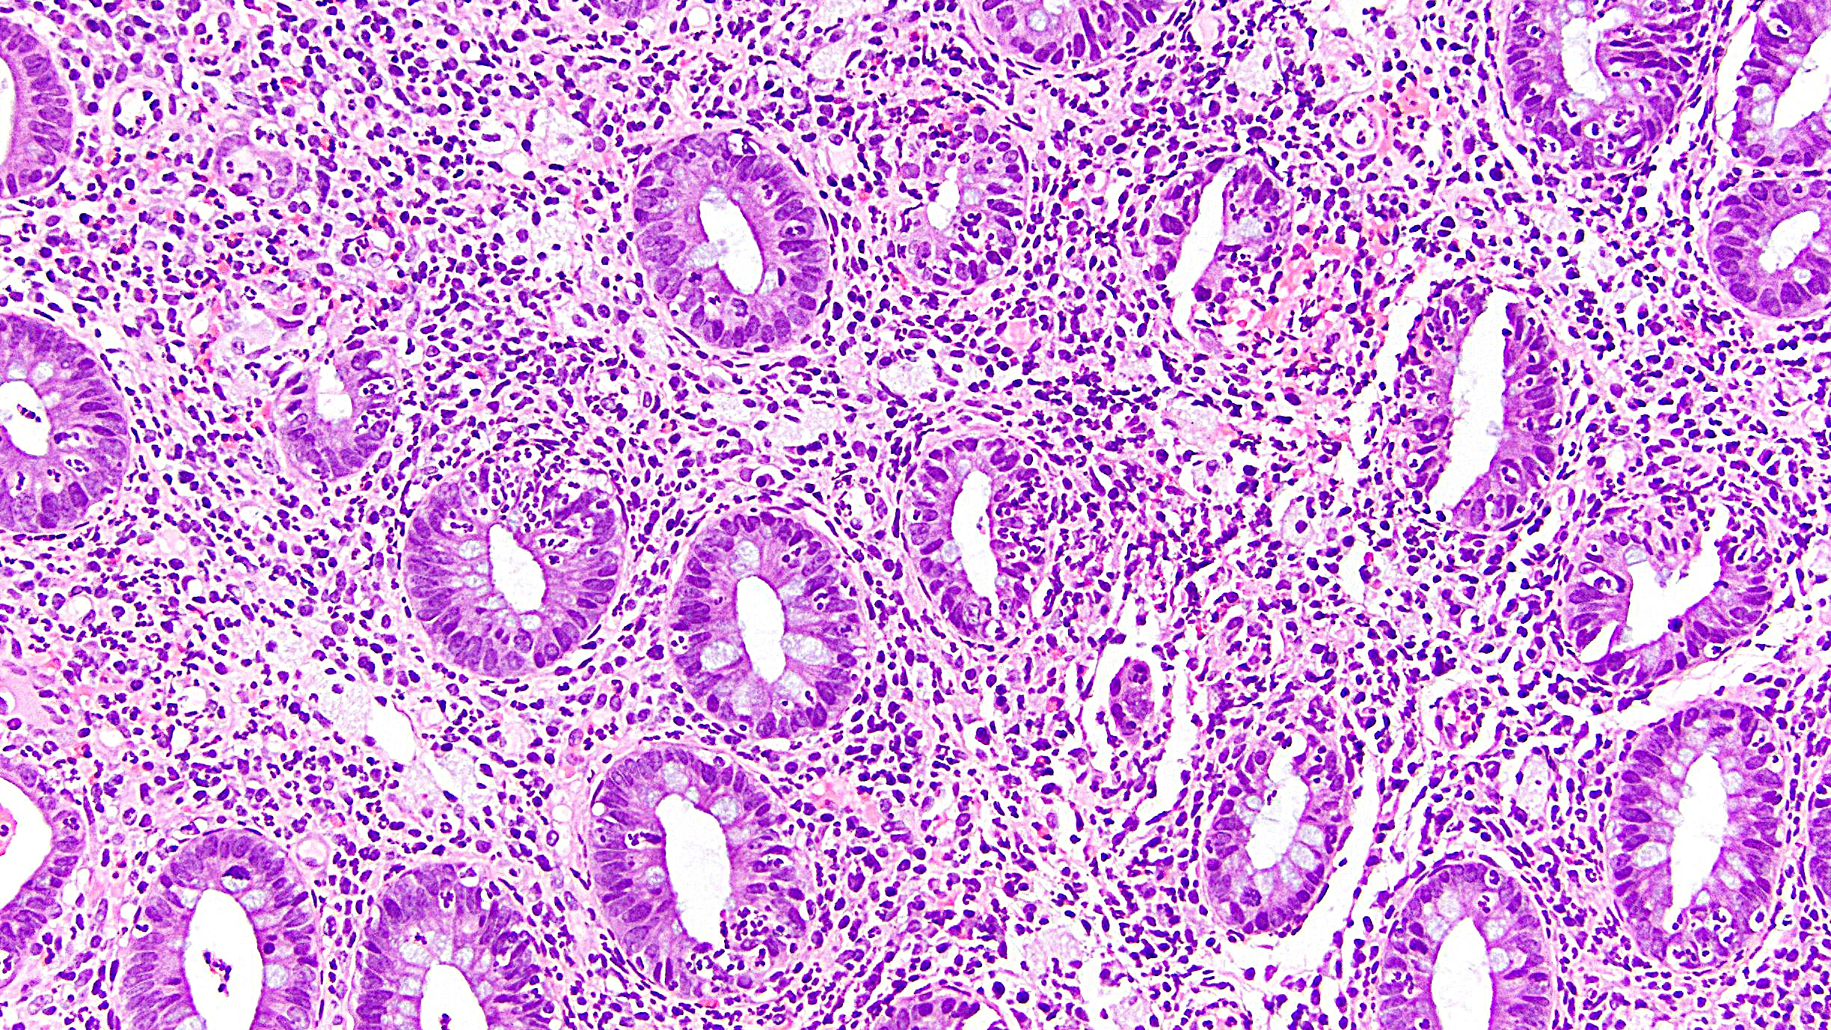
Segmental colitis

Slide 23
Diversion Colitis
Occurs in diverted segment of colon (usually rectal stump)
Probably due to loss of short-chain fatty acid exposure
Important to know why patient underwent surgery/diversion (IBD?)
Histology and symptoms may seem mismatched
Histology: prominent lymphoid aggregates; possibly superimposed IBD-like change

Slide 24
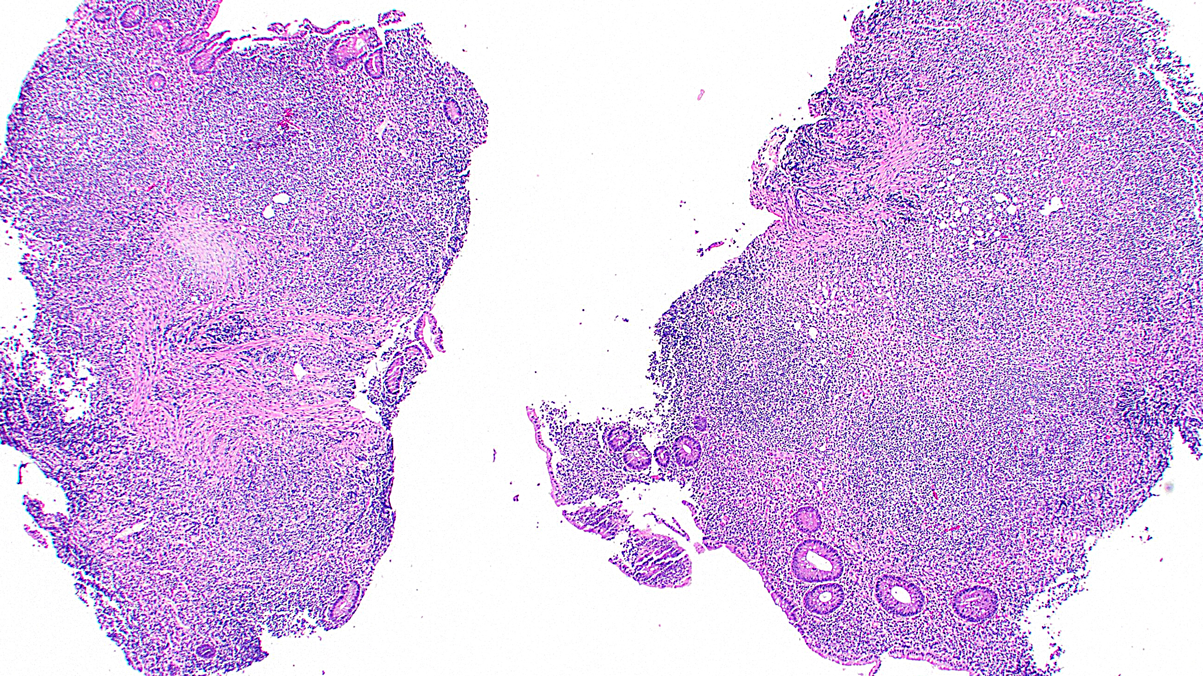
Diversion colitis

Slide 25
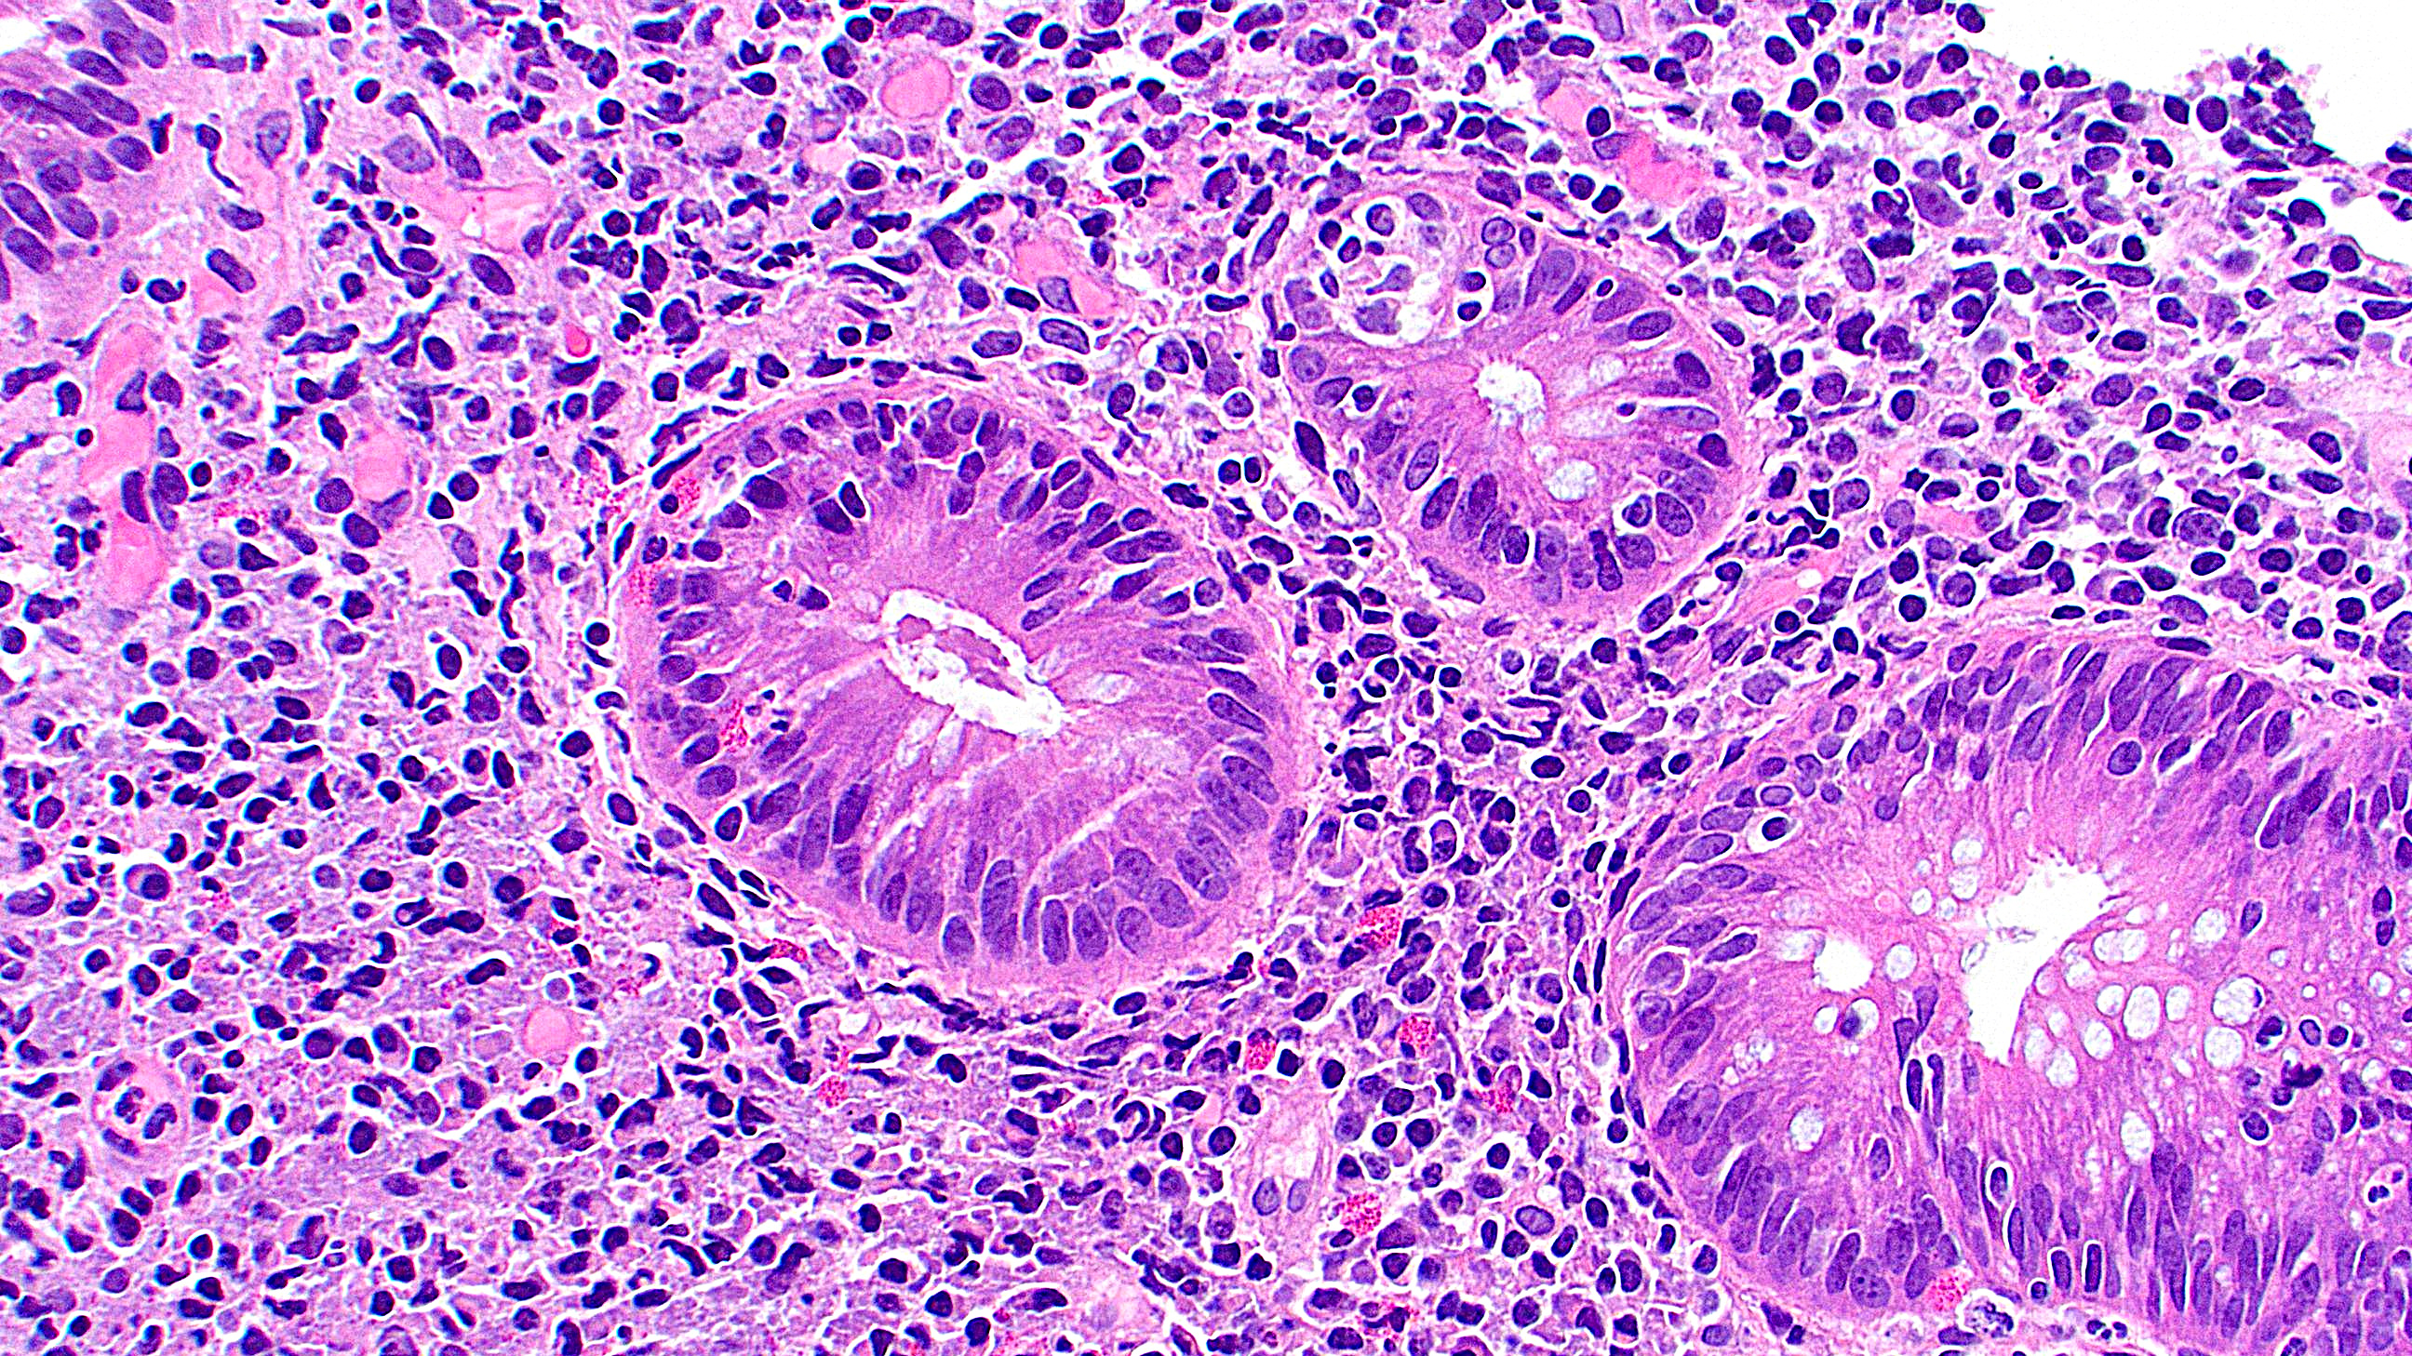
Diversion colitis

Slide 26
Drug-Induced Colitis
Wide variety of culprits and patterns of injury
Checkpoint inhibitors (CTLA4, PD1) and other immunomodulators (PI3K, TKI) are the main mimickers of IBD
Varying histology
LP expansion, acute inflammation, crypt abnormalities (as in IBD)
Increased intraepithelial lymphocytes, increased apoptosis, granulomas
Get an accurate medication list!

Slide 27
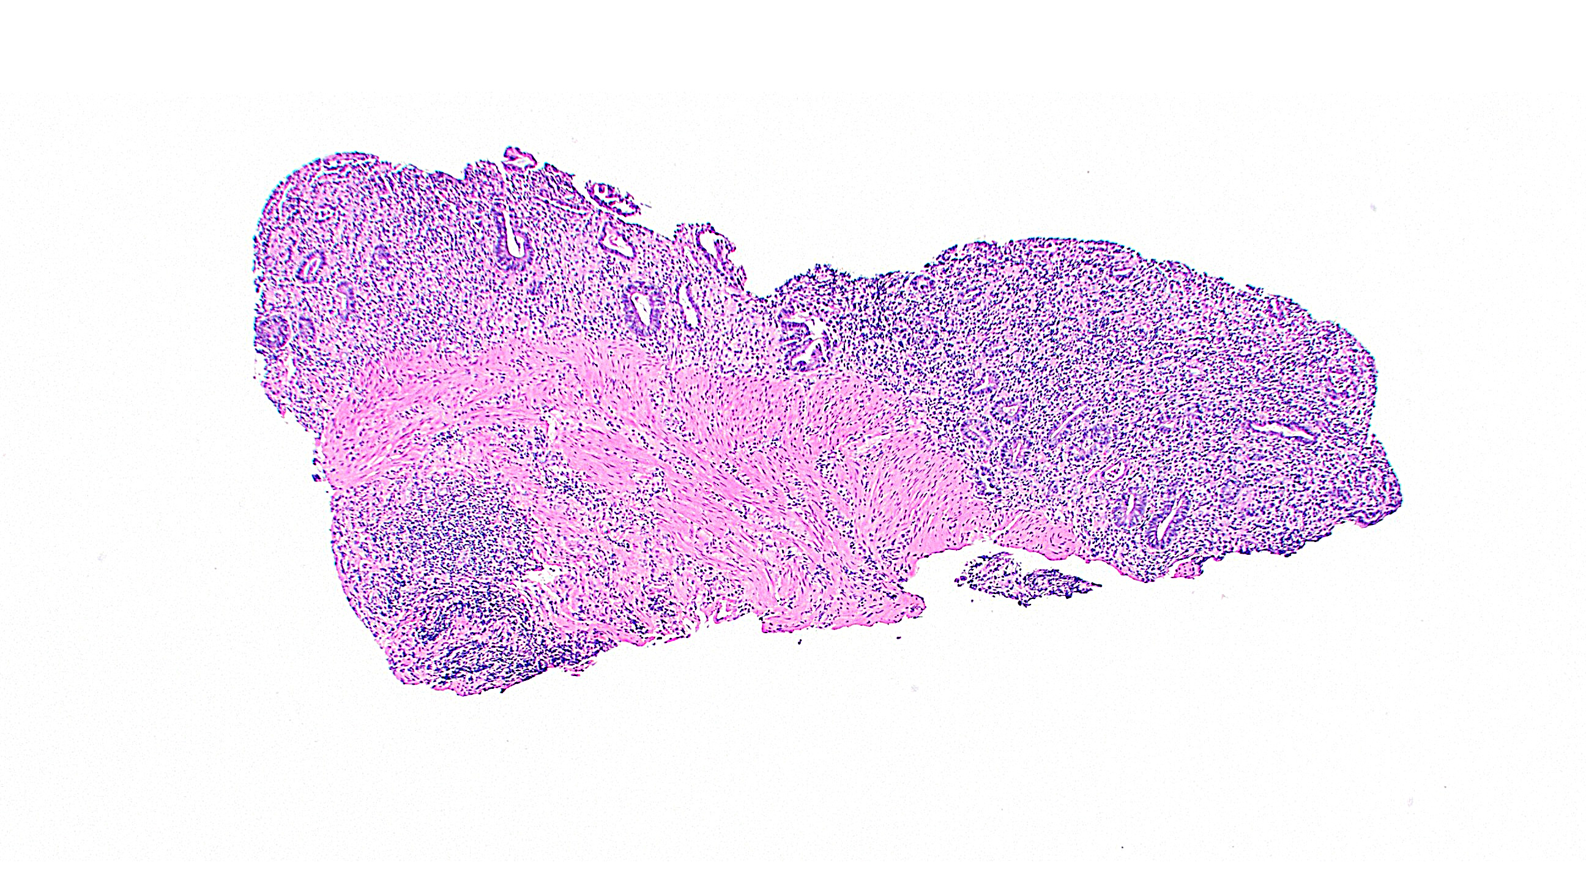
PD1 inhibitor colitis

Slide 28
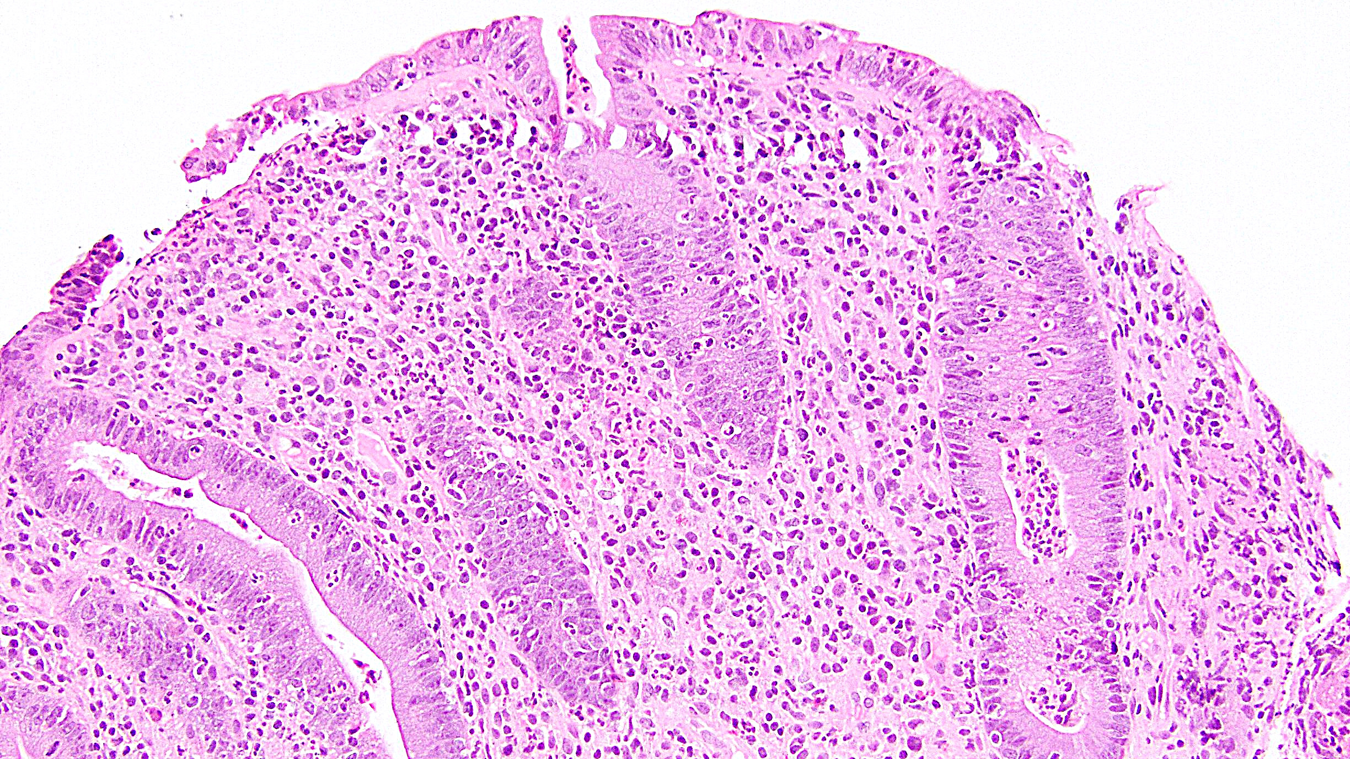
PD1 inhibitor colitis

Slide 29
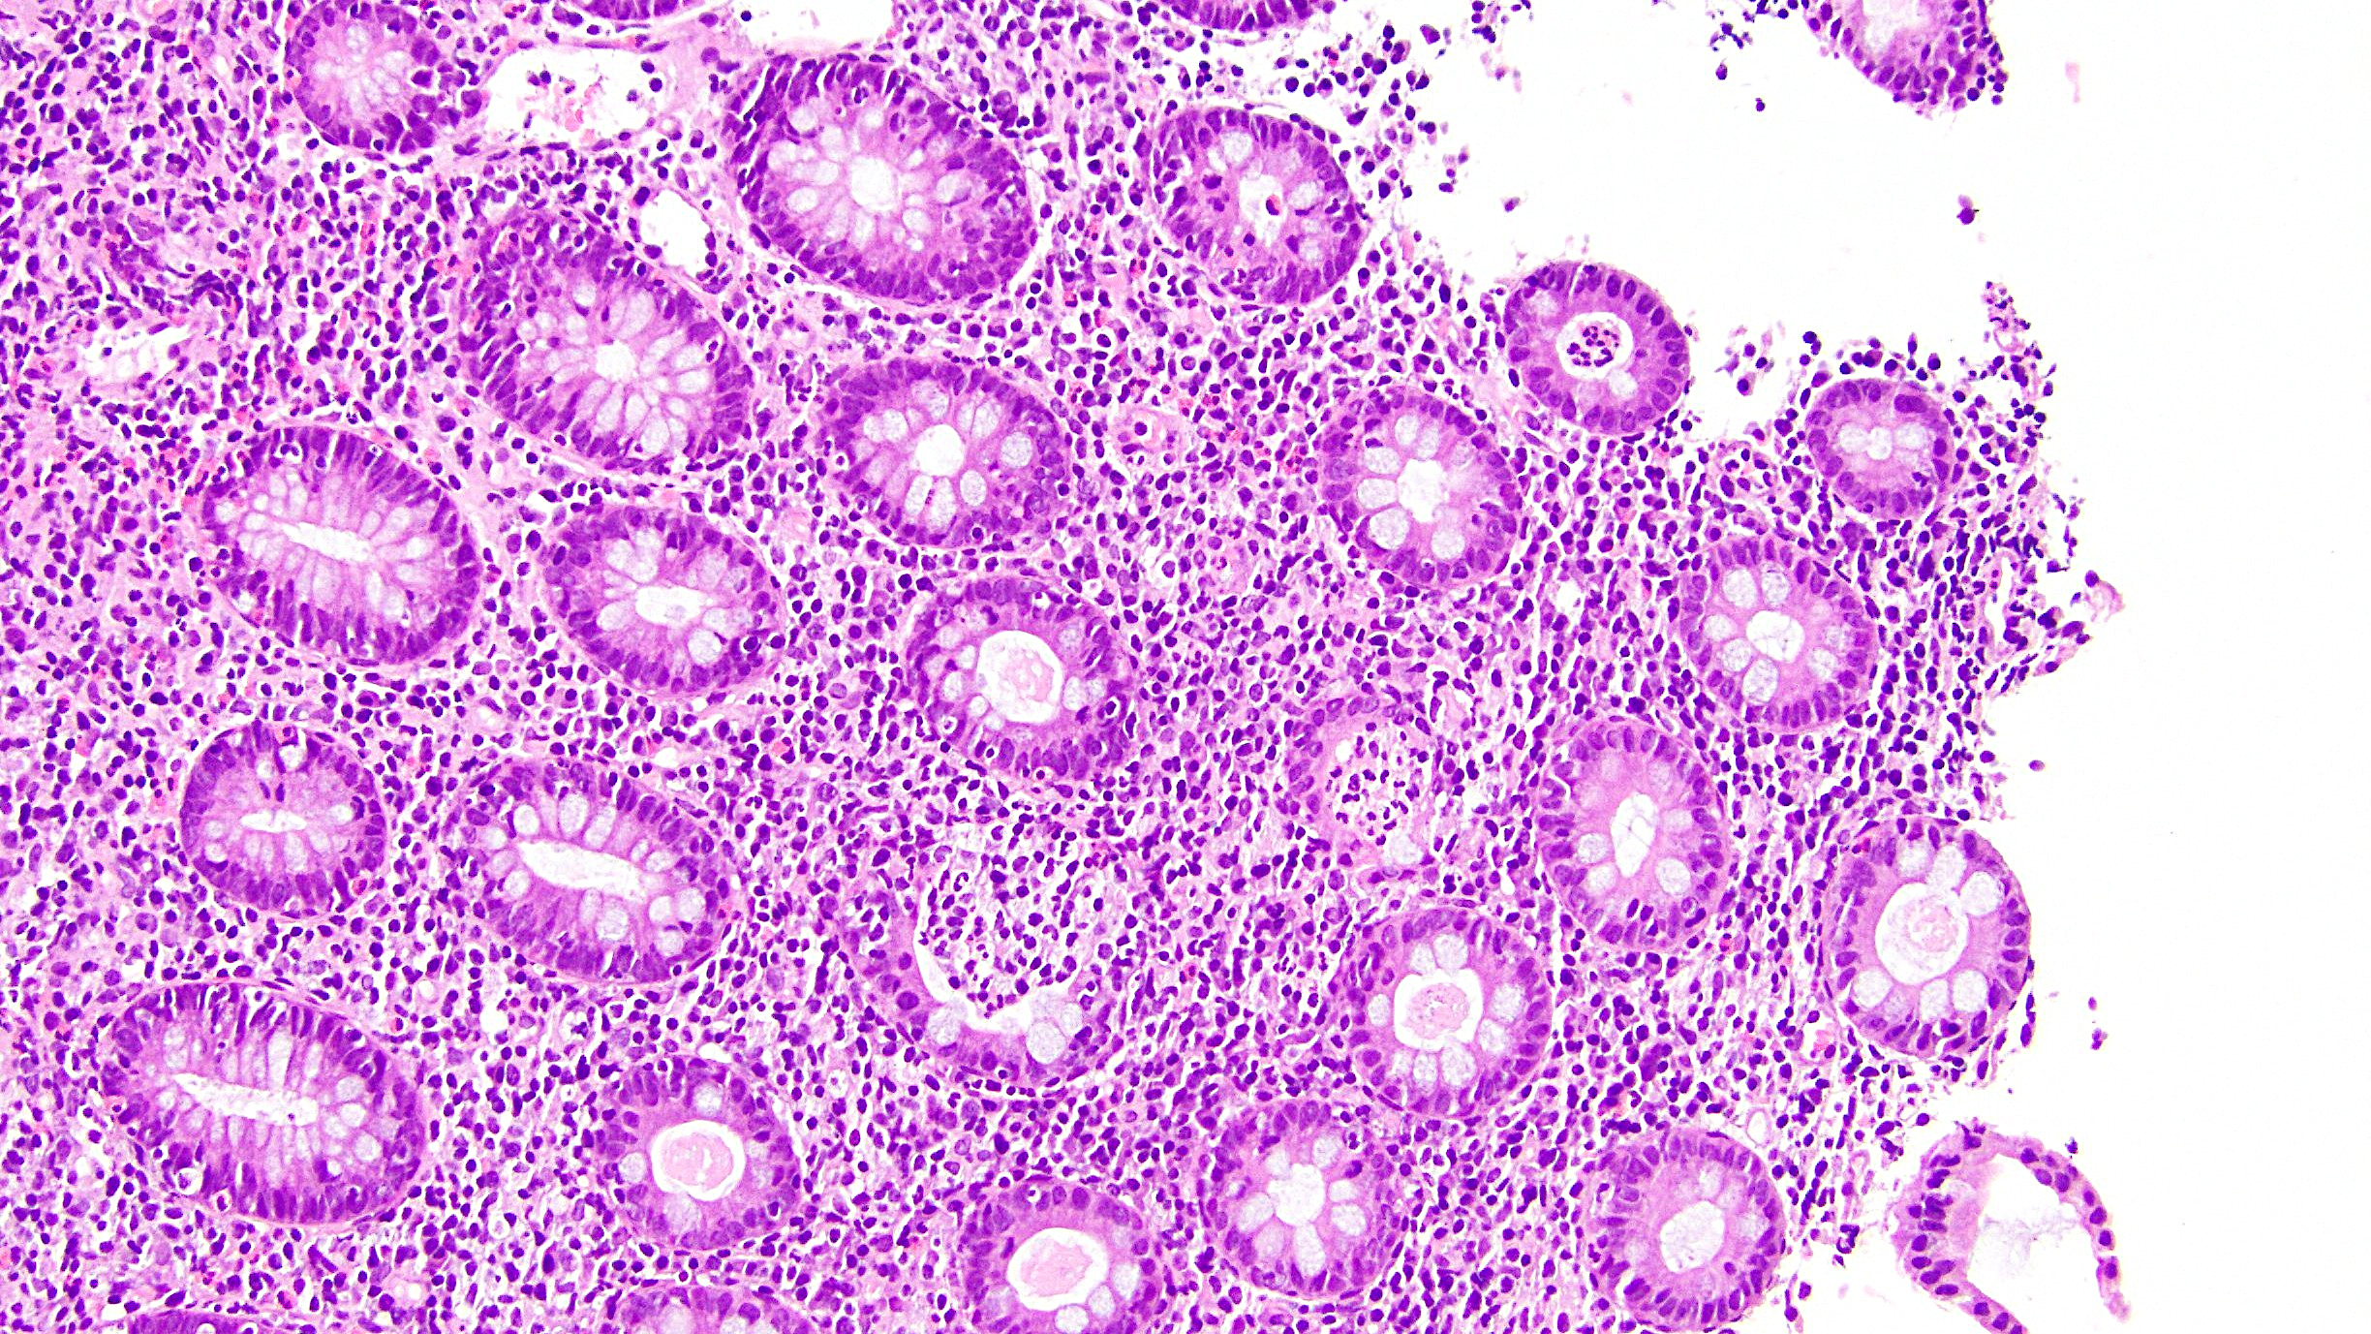
CTLA4 inhibitor colitis

Slide 30
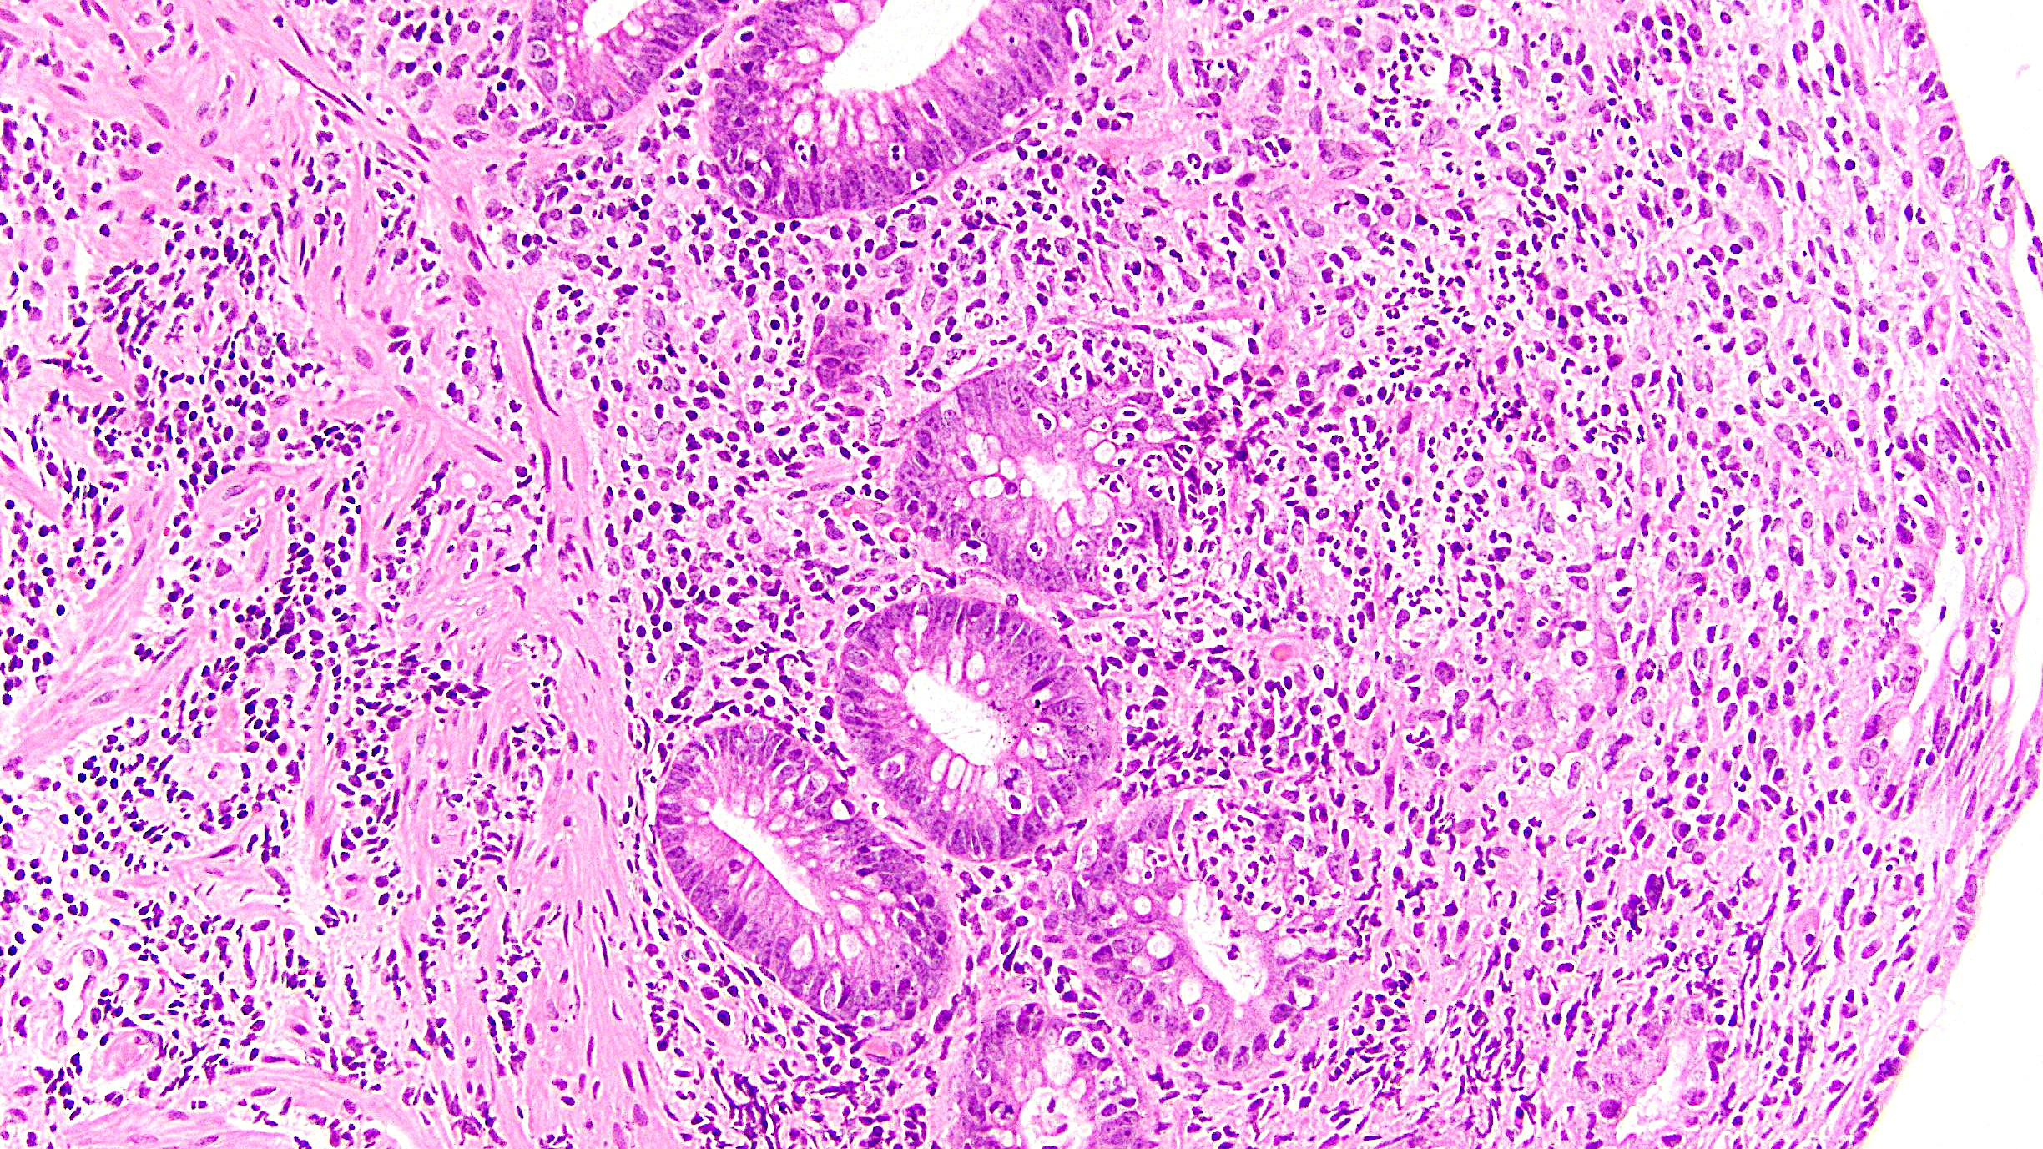
PI3K inhibitor colitis

Slide 31
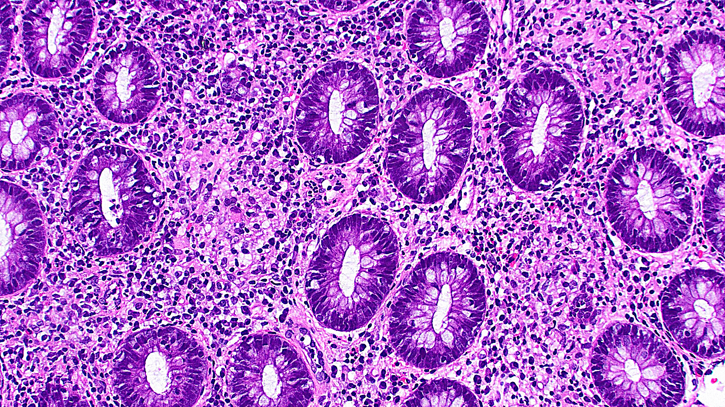
TKI colitis

Slide 32
Colitis-Associated Dysplasia
IBD patients are at increased risk of dysplasia and carcinoma
Two configurations
Visible dysplasia (polypoid; now treated like a tubular adenoma)
Invisible dysplasia (flat; more concerning, can lead to surgery)
Two subtypes
Conventional dysplasia (typical intestinal-like)
Non-conventional dysplasia (several varieties)
“DALM” is dead

Slide 33
Conventional Dysplasia
Relatively uncommon on biopsy
Reported in 1.3% of Emory IBD biopsy cases 2017-2022
Majority of colitis-associated dysplasia
91% of Emory IBD biopsy dysplasia 2017-2022
Resembles the intestinal-type dysplasia seen in sporadic tubular adenomas
Can’t really distinguish them histologically

Slide 34
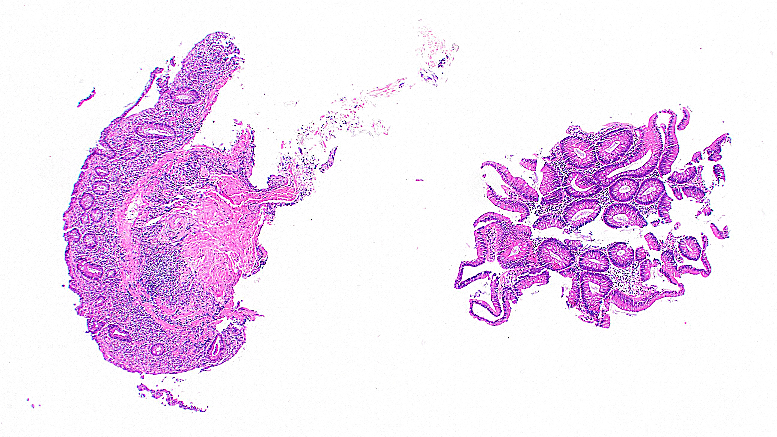
Visible colitis-associated conventional dysplasia

Slide 35
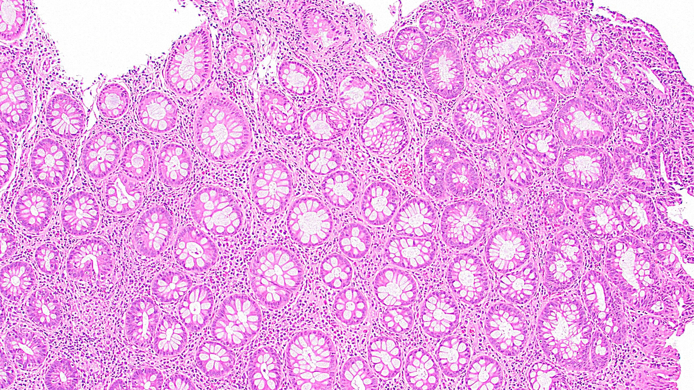
Invisible colitis-associated conventional dysplasia

Slide 36
Non-Conventional Dysplasia
1. Hypermucinous dysplasia
2. Crypt cell dysplasia
3. Goblet cell-deficient dysplasia
4. Dysplasia with increased Paneth cell differentiation
5. Sessile serrated lesion-like dysplasia
6. Traditional serrated adenoma-like dysplasia
7. Serrated dysplasia NOS

Slide 37
Hypermucinous Dysplasia
~2% of dysplasia in IBD
First major study published in 1999
Usually presents as a visible lesion, more often left-sided
Villiform architecture, abundant intracytoplasmic mucin
High rates of KRAS mutation and subsequent HGD or carcinoma

Slide 38
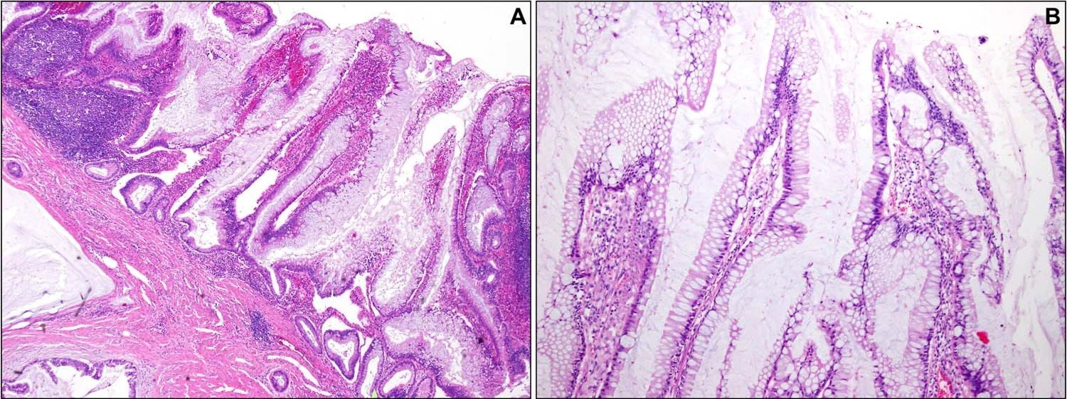
Hypermucinous Dysplasia
Choi WT, et al. Mod Pathol. 2020;33:933-943

Slide 39
Crypt Cell Dysplasia
~4% of dysplasia in IBD
Usually presents as a left-sided flat lesion
Patients often have PSC
Crypts show enlarged, hyperchromatic, spread-out, rounded nuclei
No architectural changes
Surface should not be involved (problems: ulceration, sectioning)
High rates of subsequent HGD or carcinoma

Slide 40
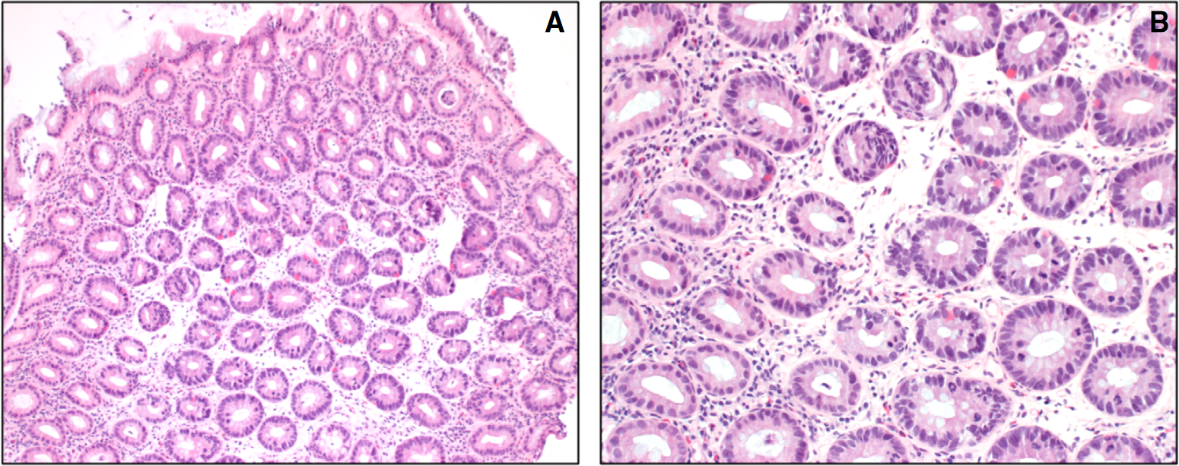
Crypt Cell Dysplasia
Choi WT, et al. Mod Pathol. 2020;33:933-943

Slide 41
Goblet Cell-Deficient Dysplasia
~3% of dysplasia in IBD
More often flat, but may be seen in large polyps
Resembles conventional dysplasia, but has few/no goblet cells
Could well be a variant of conventional dysplasia
Patients at increased risk of HGD/carcinoma

Slide 42
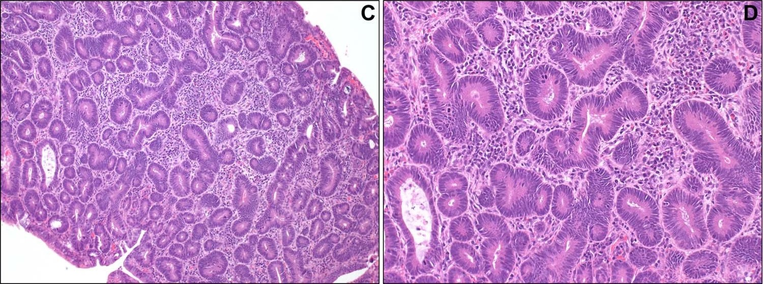
Goblet Cell-Deficient Dysplasia
Choi WT, et al. Mod Pathol. 2020;33:933-943

Slide 43
Dysplasia with increased Paneth cell differentiation
~13% of dysplasia in IBD
Usually seen in small polypoid lesions
Resembles conventional dysplasia, but has lots of Paneth cells
Honestly probably a variant of conventional dysplasia
Patients not at particularly increased risk of HGD/carcinoma

Slide 44
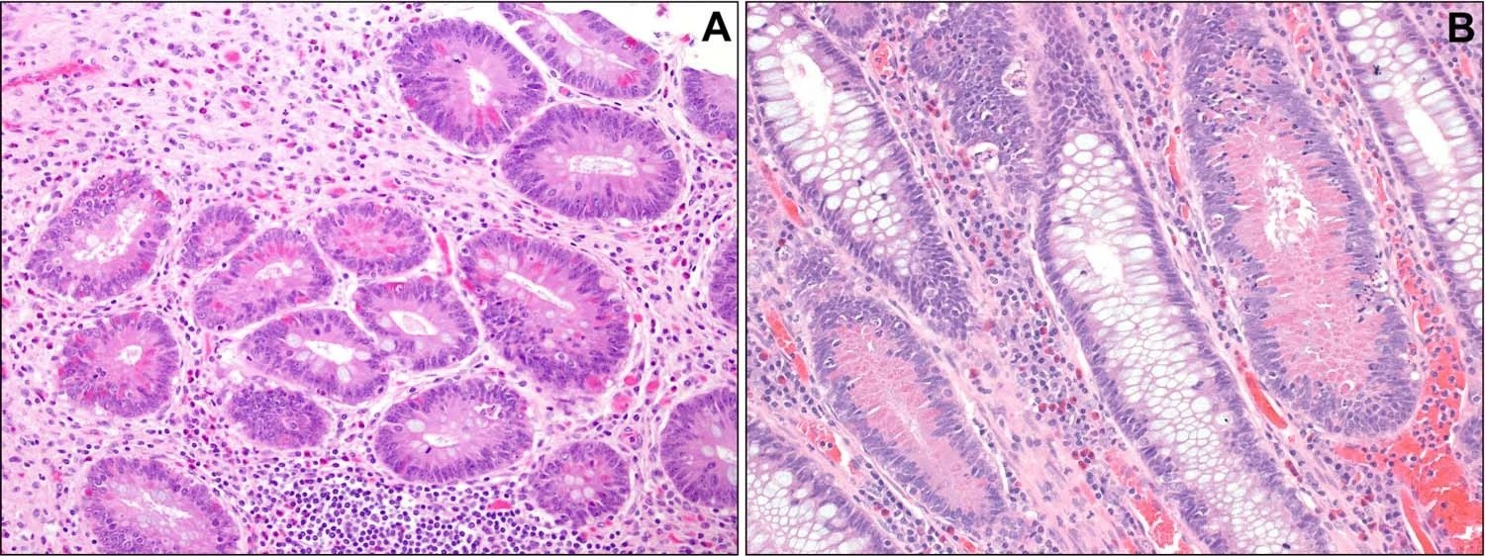
Dysplasia with increased Paneth cell differentiation
Choi WT, et al. Mod Pathol. 2020;33:933-943

Slide 45
Sessile Serrated Lesion-Like Dysplasia
~1% of dysplasia in IBD
A lot like dysplastic SSLs in non-IBD patients
Visible on endoscopy
Usually right-sided
L- or T-shaped crypts
Shows cytologic dysplasia

Slide 46
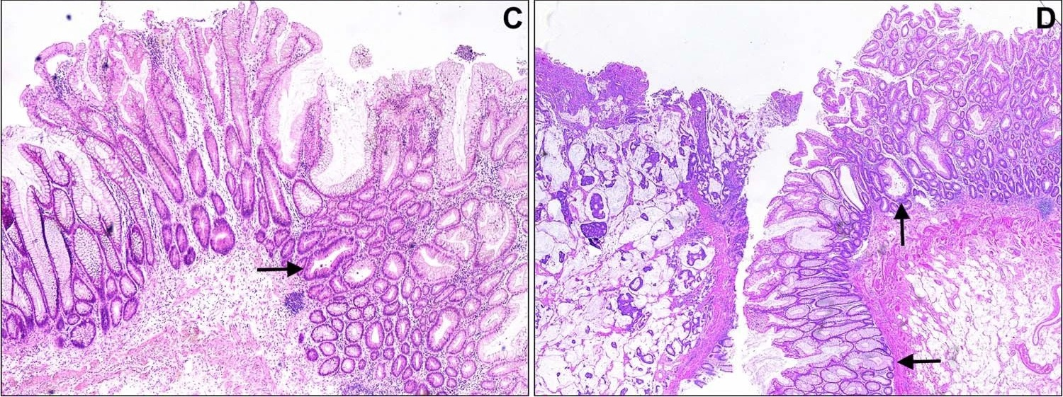
Sessile Serrated Lesion-Like Dysplasia
Choi WT, et al. Mod Pathol. 2020;33:933-943

Slide 47
Traditional Serrated Adenoma-Like Dysplasia
~1% of dysplasia in IBD
A lot like TSAs in non-IBD patients

Slide 48
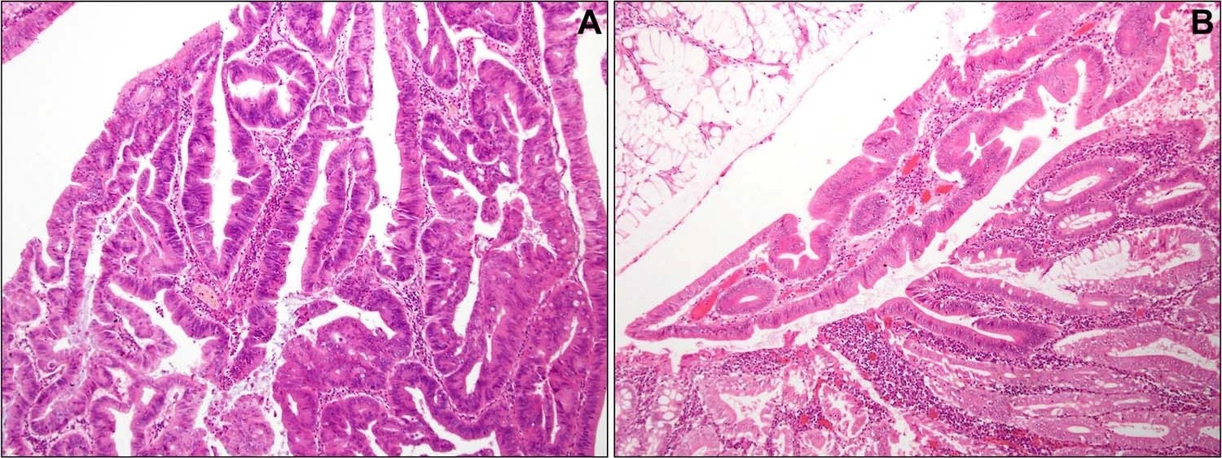
Traditional Serrated Adenoma-Like Dysplasia
Choi WT, et al. Mod Pathol. 2020;33:933-943

Slide 49
Serrated Dysplasia NOS
Very rare
Not a lot of solid data here
Basically a wastebasket term for lesions that look kinda serrated but don’t fit for SSL-like or TSA-like

Slide 50
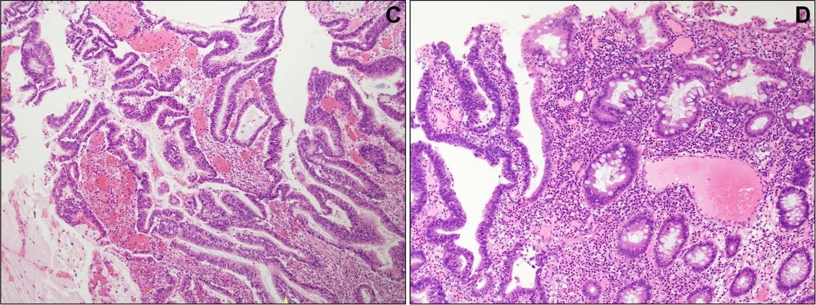
Serrated Dysplasia NOS
Choi WT, et al. Mod Pathol. 2020;33:933-943

Slide 51
Am I Missing Non-Conventional Forms on Bx?
Limited data, but probably not
Hypermucinous is tricky; probably often called indefinite
Crypt cell is also tricky; probably often called indefinite or HGD
Goblet cell-deficient and Paneth cell-rich probably just called NOS
SSL-like and TSA-like probably just getting called dSSL and TSA
Serrated NOS is weird, probably flagged as indefinite or LGD
Patients often also have conventional dysplasia

Slide 52
Does IHC Help with Non-Conventional Forms?
Worth trying in difficult cases, to distinguish from reactive change
I have become a convert
p53 staining can be aberrant
Nearly every cell stains, or no cell stains
SATB2 staining can be lost
~40% of colitis-associated dysplasia

Slide 53
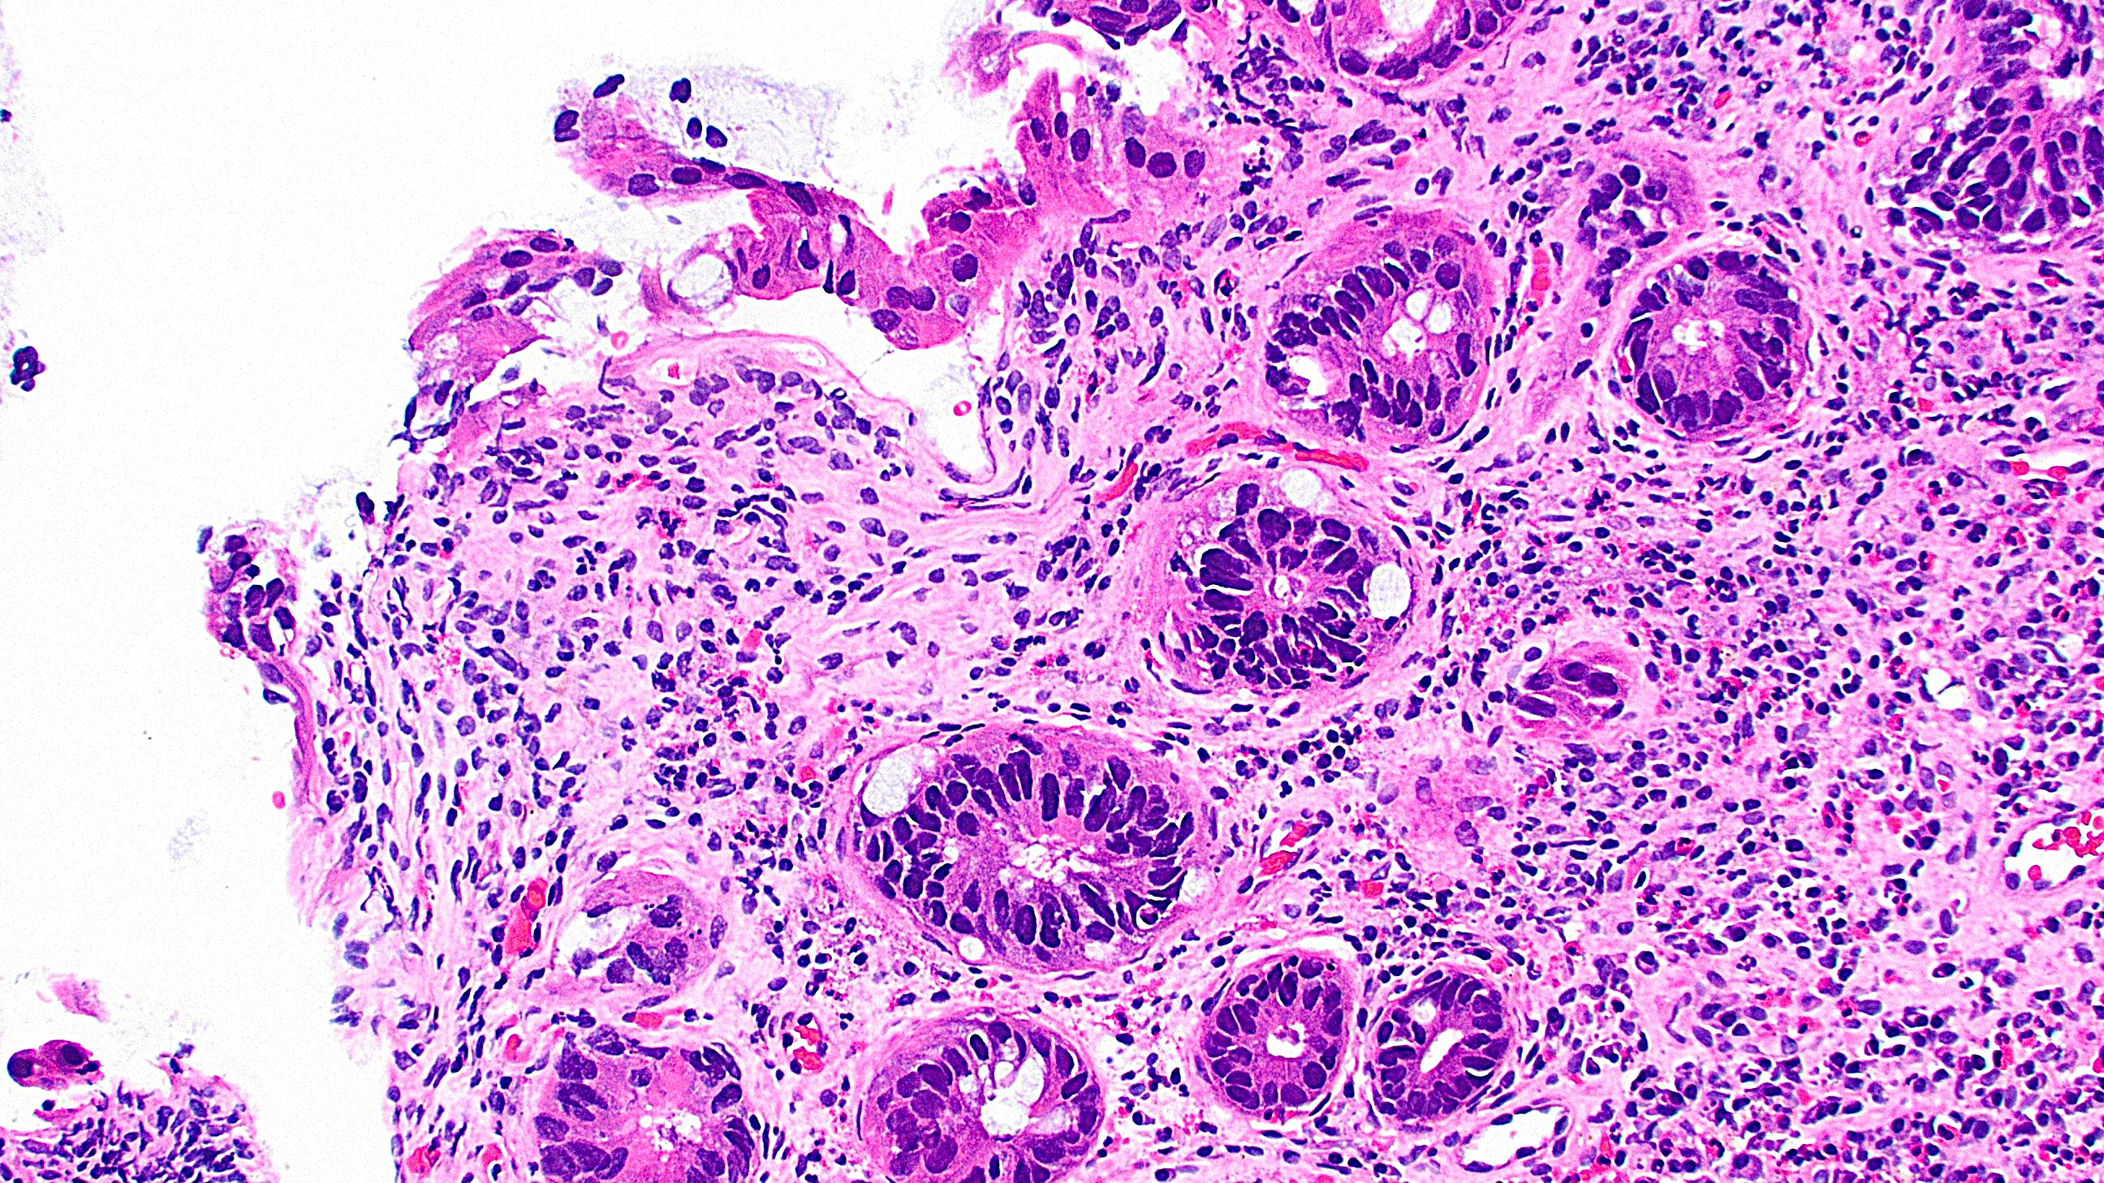
Crypt cell dysplasia? H&E

Slide 54
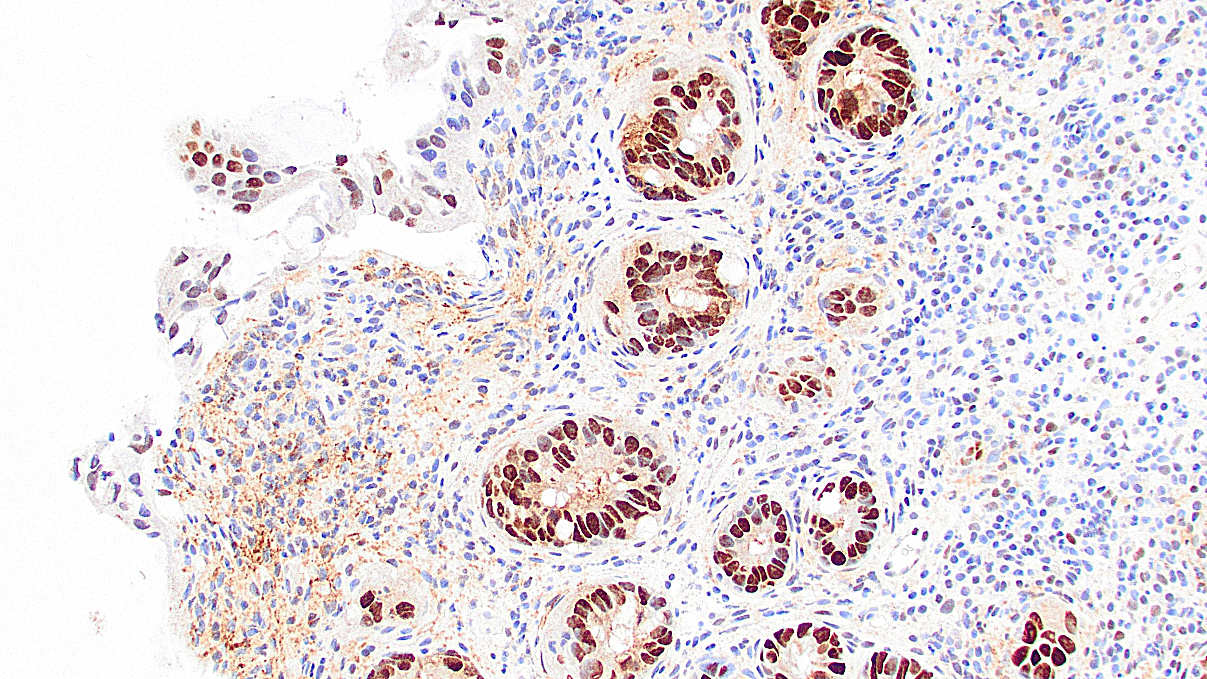
Crypt cell dysplasia, p53

Slide 55
My Signout Approach for Dysplasia in IBD
Polyp: “Polypoid low-grade dysplasia”
Can’t distinguish colitis-associated dysplasia from sporadic TA
Clinicians don’t really care anymore anyway
LGD vs. HGD same as for TA
Flat biopsy: Generally descriptive
A comment is a good idea
Specifically naming non-conventional forms is not standard practice … yet
LGD vs. HGD can be challenging, especially for non-conventional forms
Low threshold for showing a colleague

Slide 56
References
Cerilli LA, et al. The differential diagnosis of colitis in endoscopic biopsy specimens: a review article. Arch Pathol Lab Med. 2012;136:854-864.
Choi EK, et al. Chronic Colitis in Biopsy Samples: Is It Inflammatory Bowel Disease or Something Else. Surg Pathol Clin. 2017;10:841-861.
Choi WT, et al. Nonconventional dysplasia in patients with inflammatory bowel disease and colorectal carcinoma: a multicenter clinicopathologic study. Mod Pathol. 2020;33:933-943.
Geraghty JM, et al. Diversion colitis: histological features in the colon and rectum after defunctioning colostomy. Gut. 1991;32:1020-1023.
Jessurun J. The Differential Diagnosis of Acute Colitis: Clues to a Specific Diagnosis. Surg Pathol Clin. 2017;10:863-885.
Ma C, et al. Loss of SATB2 Expression Is a Biomarker of Inflammatory Bowel Disease-associated Colorectal Dysplasia and Adenocarcinoma. Am J Surg Pathol. 2019;43:1314-1322.
Mosli MH, et al. Histologic scoring indices for evaluation of disease activity in ulcerative colitis. Cochrane Database Syst Rev. 2017;5:CD011256.
Novak G, et al. Histologic scoring indices for evaluation of disease activity in Crohn's disease. Cochrane Database Syst Rev. 2017;7:CD012351.
Odze R. Diagnostic problems and advances in inflammatory bowel disease. Mod Pathol. 2003;16:347-358.
Tursi A, et al. Histopathology of segmental colitis associated with diverticulosis resembles inflammatory bowel diseases. J Clin Gastroenterol. 2015;49:350-351.
Wen KW, et al. DNA flow cytometric and interobserver study of crypt cell atypia in inflammatory bowel disease. Histopathology. 2019;75:578-588.
Zhang ML, et al. Histopathology of Gastrointestinal Immune-related Adverse Events: A Practical Review for the Practicing Pathologist. Am J Surg Pathol. 2022;46:e15-e26.

Slide 57
Questions?

Slide 58
Thank You!

